Slide 1

PREPARATION FOR THE OBOLO BIBLE

Slide 2
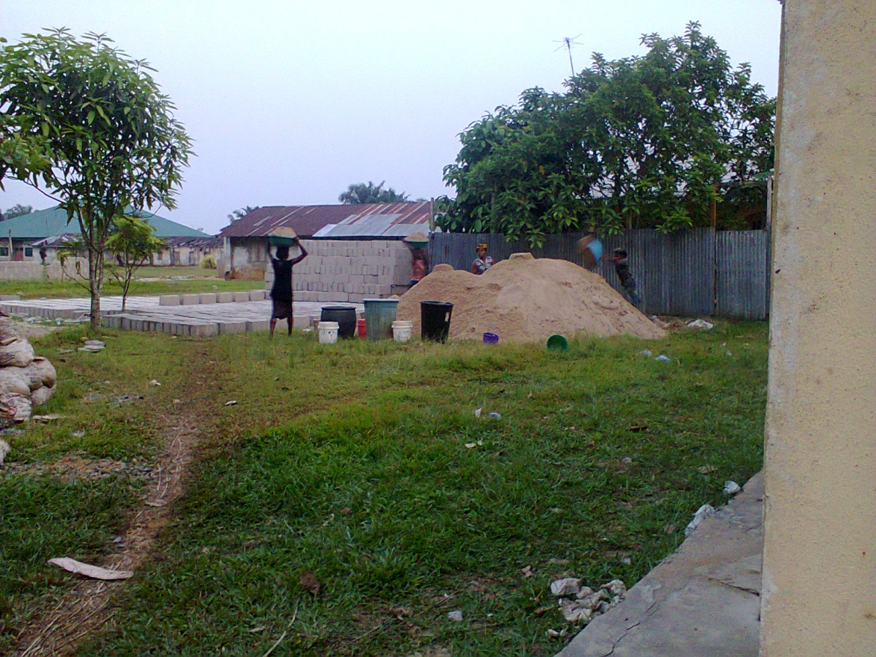
Sand and block molding for Bible Warehouse

Slide 3
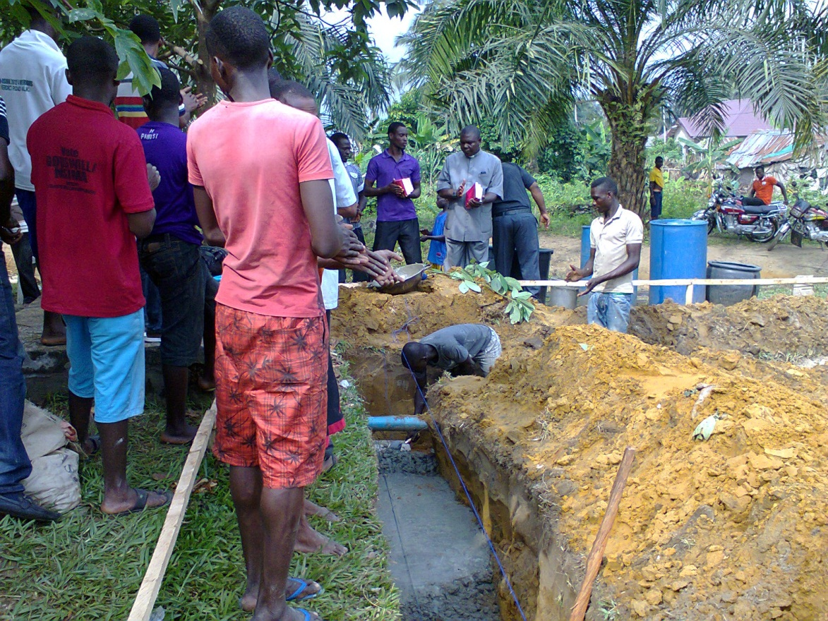
Foundation laying ceremony

Slide 4
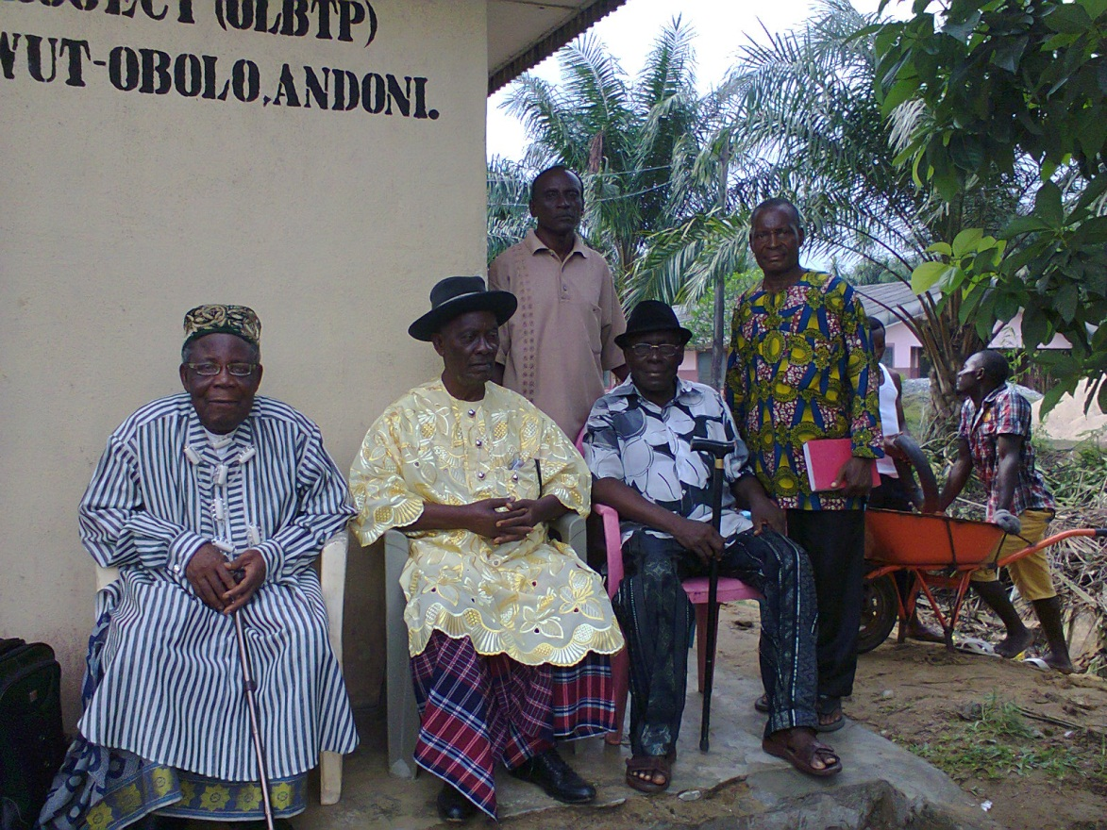
President, Coordinator, Translator, & others at the Foundation Laying Ceremony

Slide 5
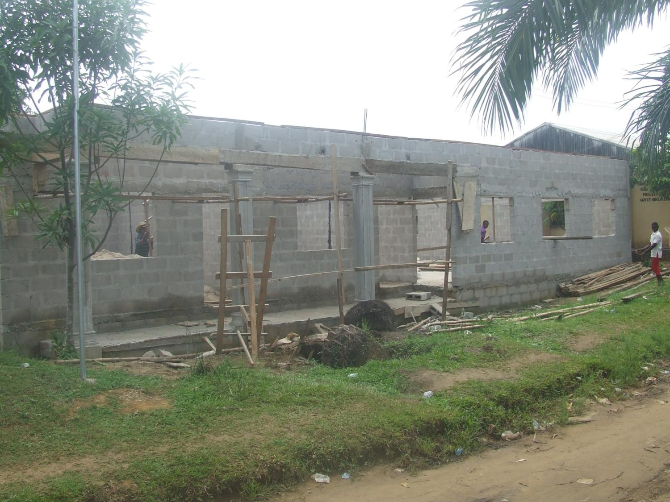
Block work completed
(in two weeks)

Slide 6
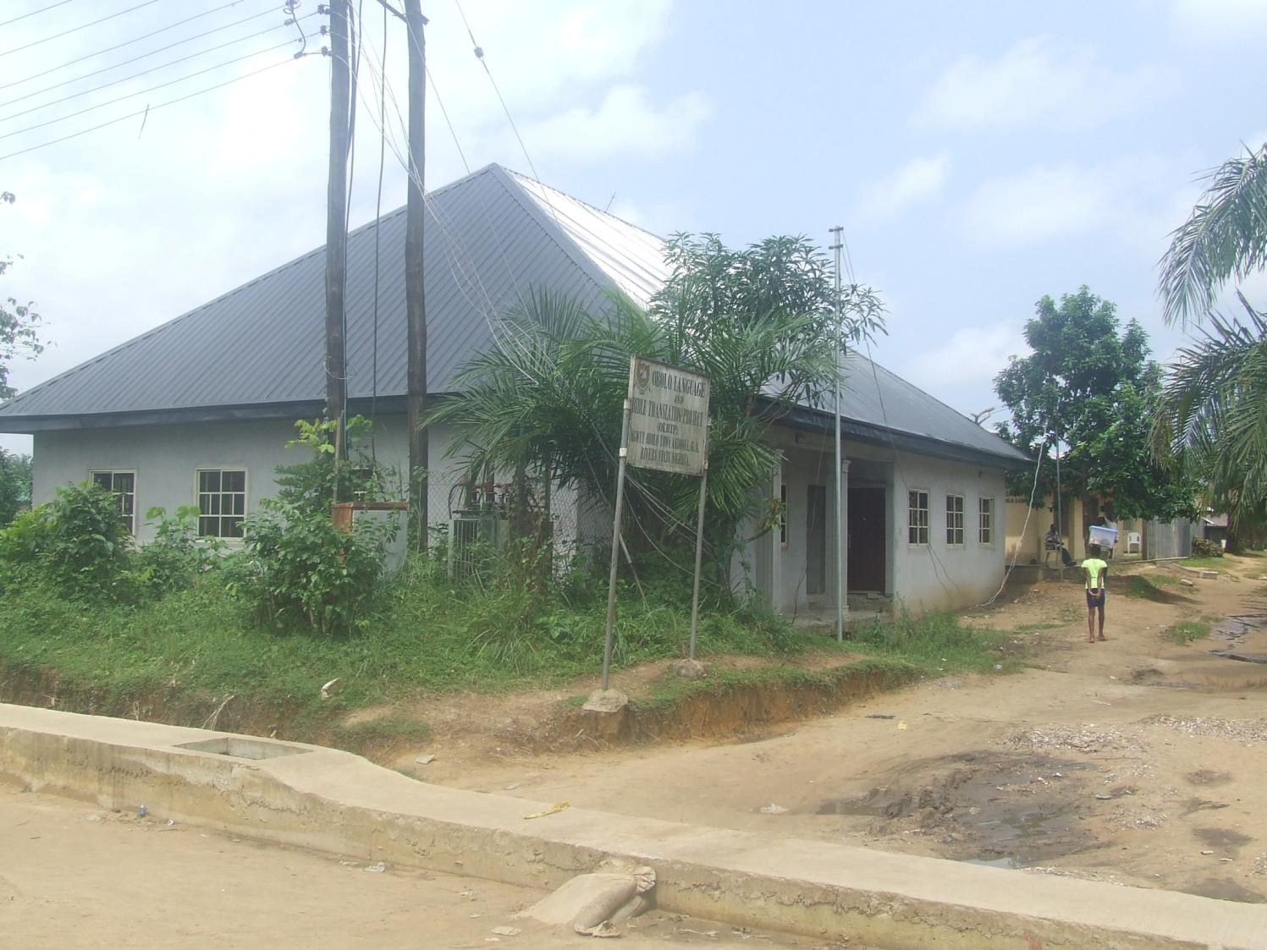
Bible Warehouse completed
(in Two Months)

Slide 7
ARRIVAL OF THE OBOLO BIBLE

Slide 8
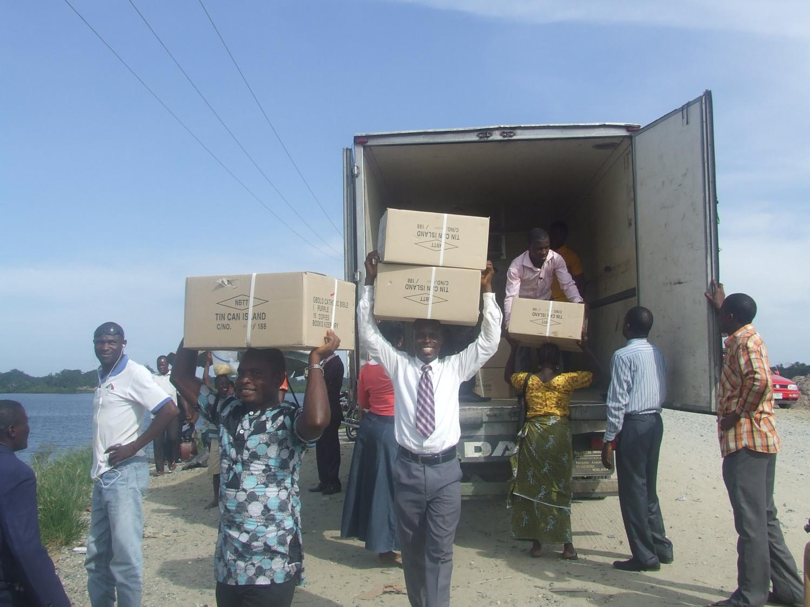
Offloading from delivery van

Slide 9
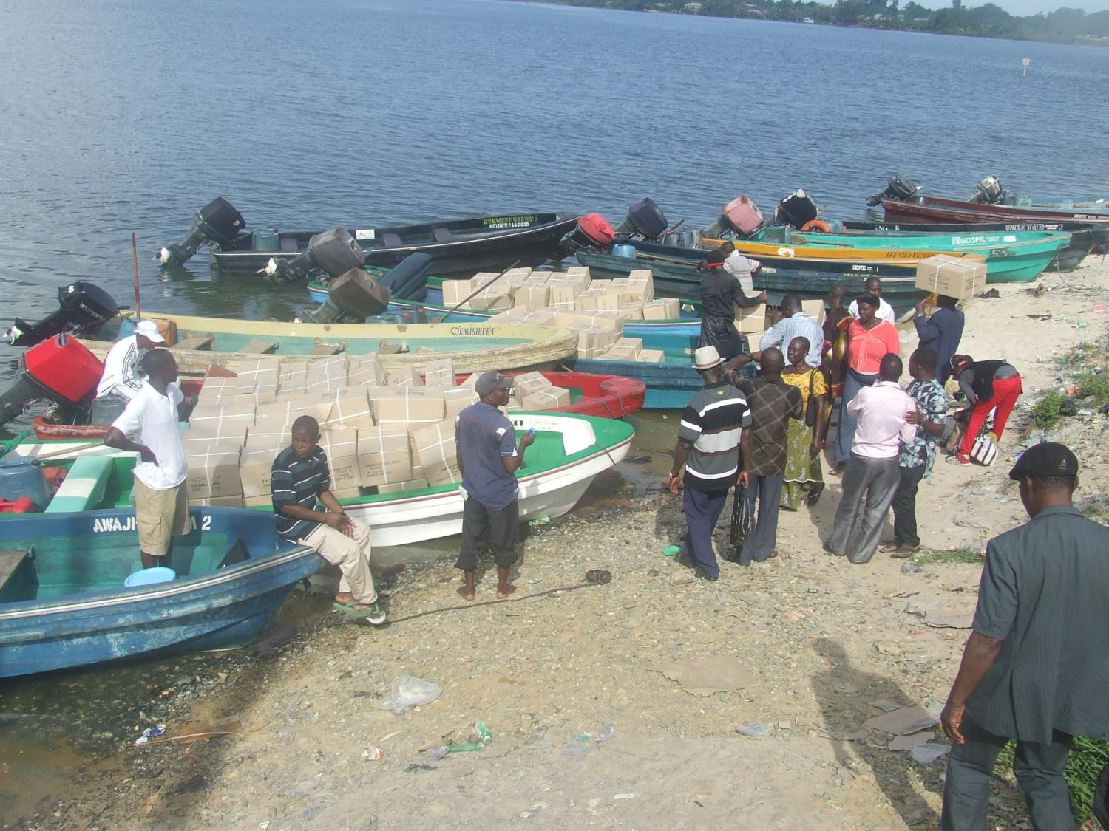
Loading onto Council boats

Slide 10
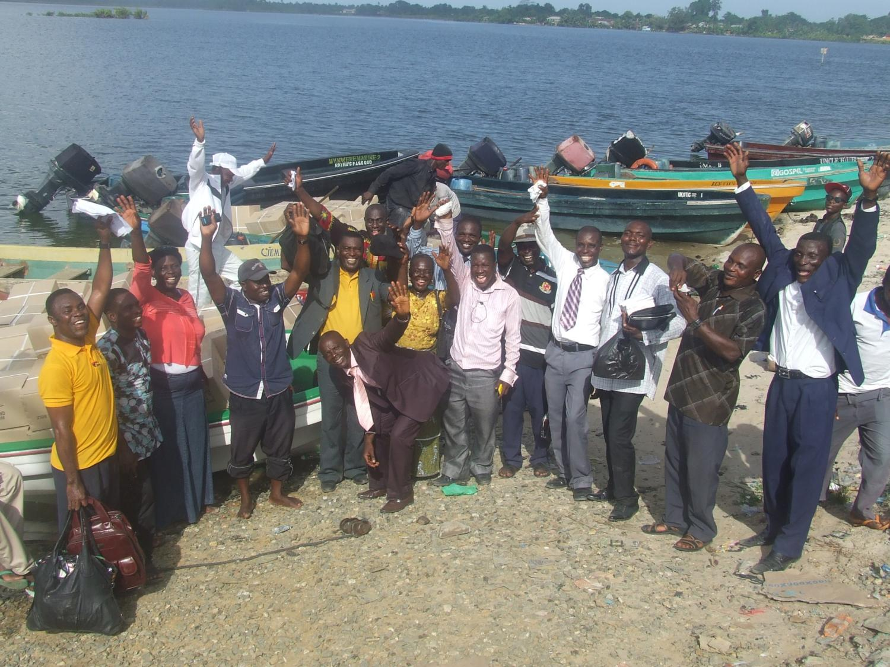
Loaders rejoice.
Hurray! Praise the Lord!!

Slide 11
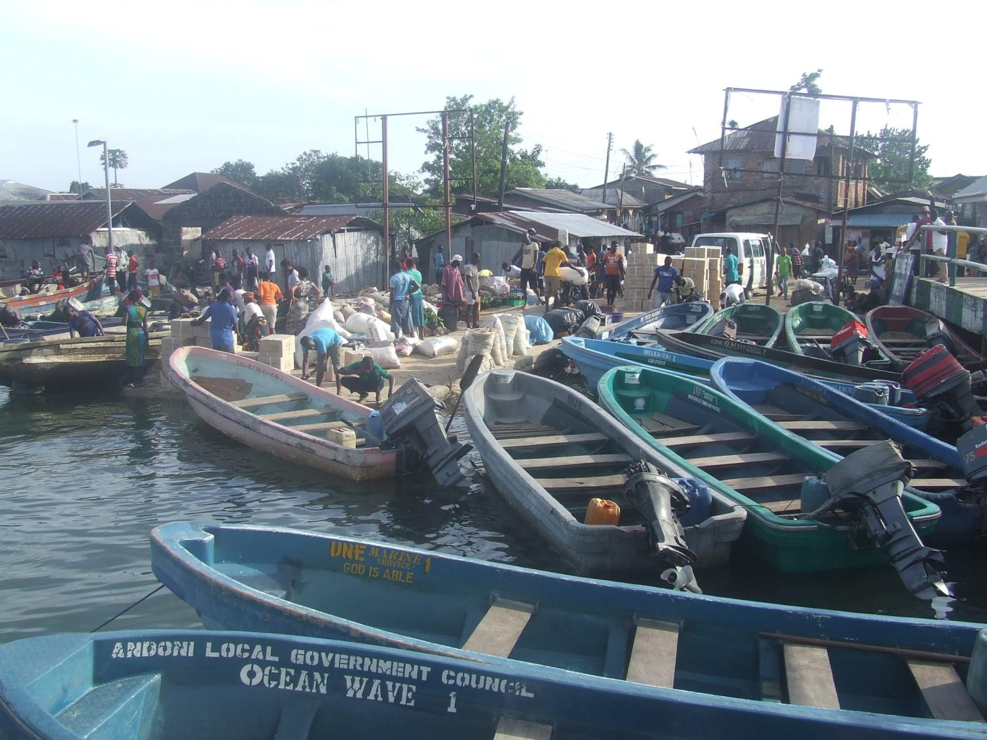
From Council boats into Council bus …

Slide 12
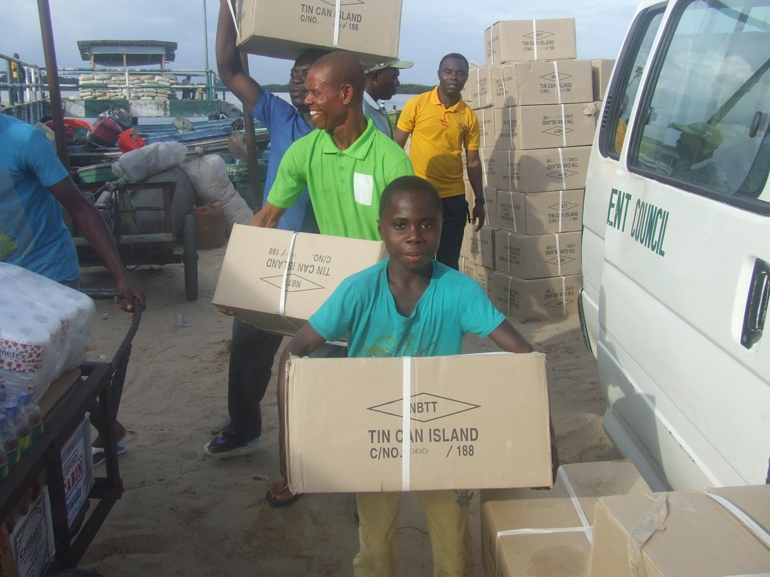
… by men and boys

Slide 13
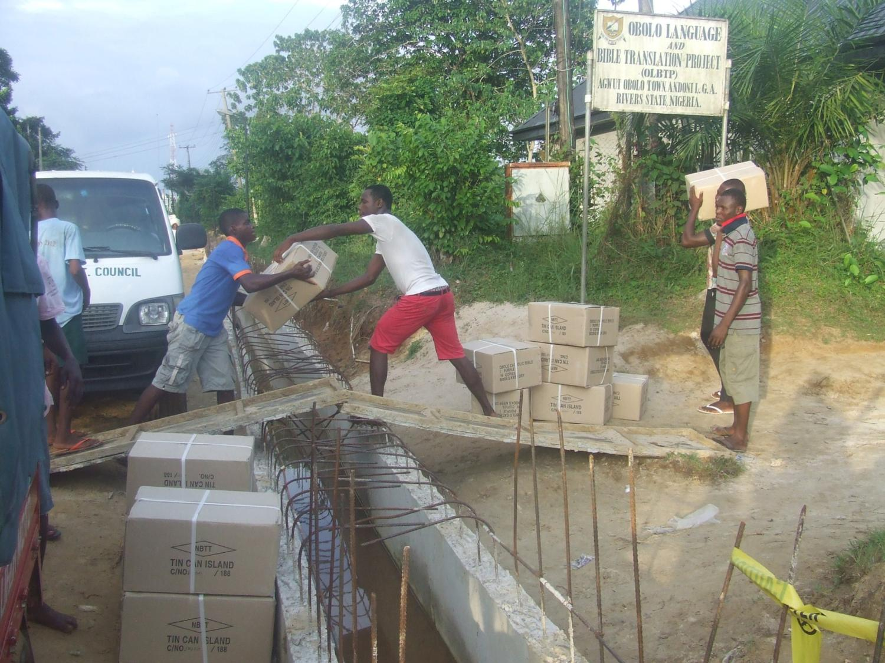
Offloading from bus into Project Office…

Slide 14
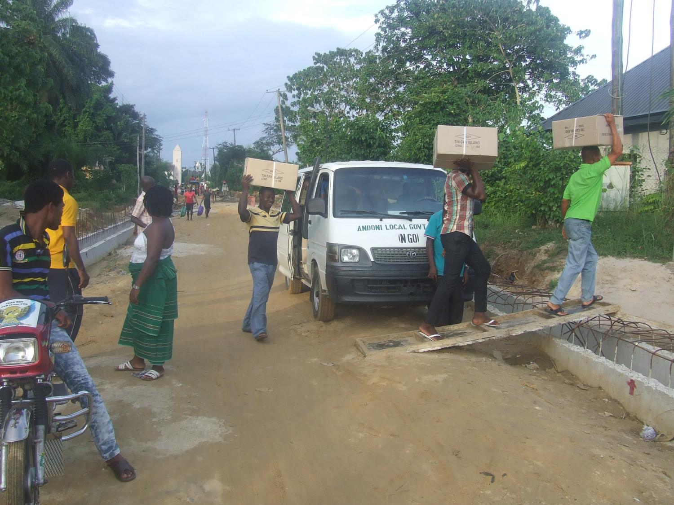

Slide 15
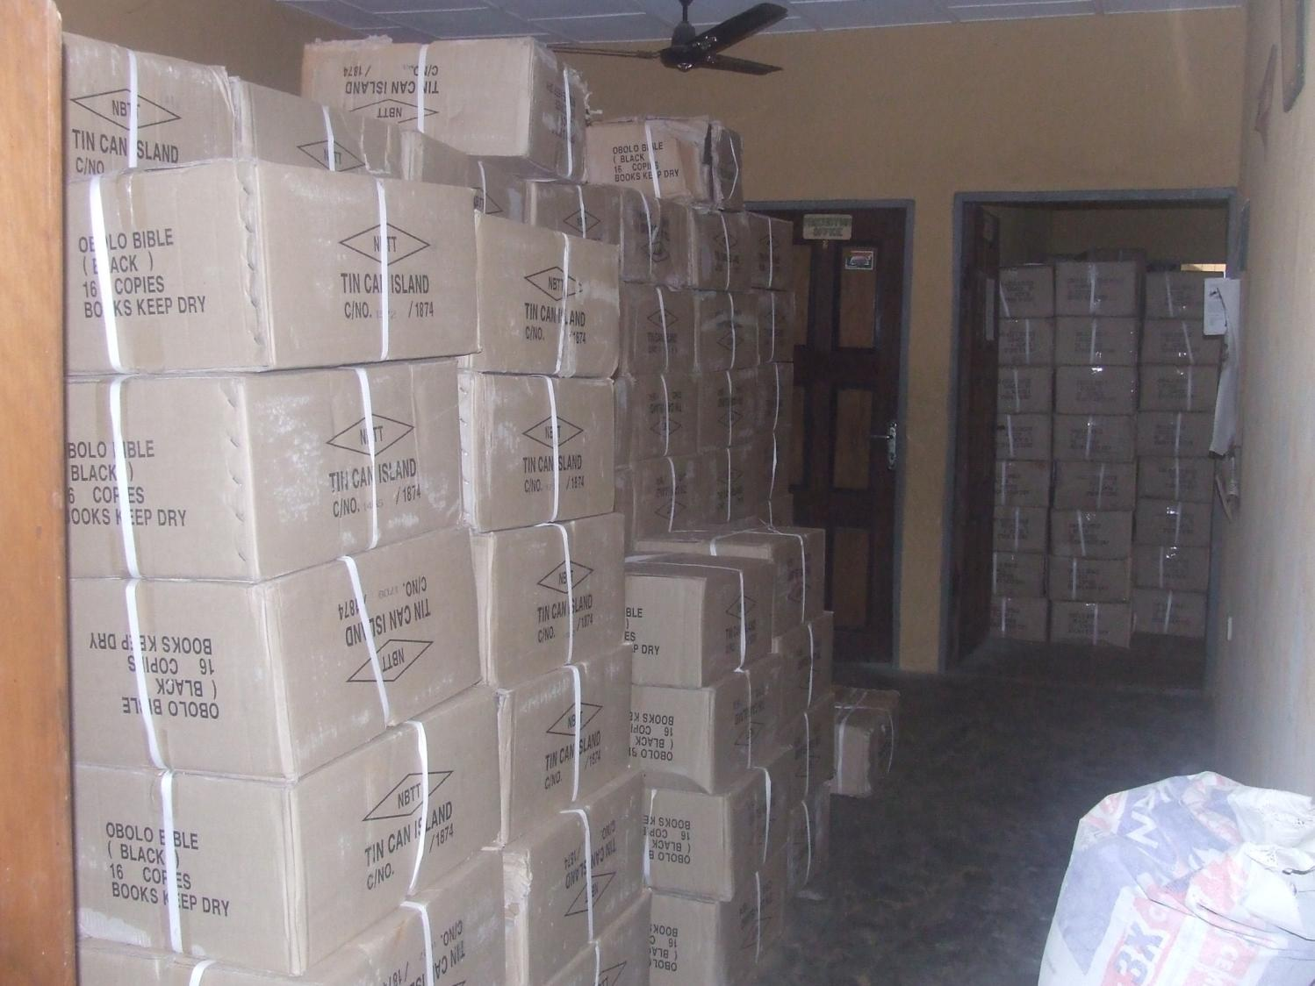
…all the rooms were filled…

Slide 16
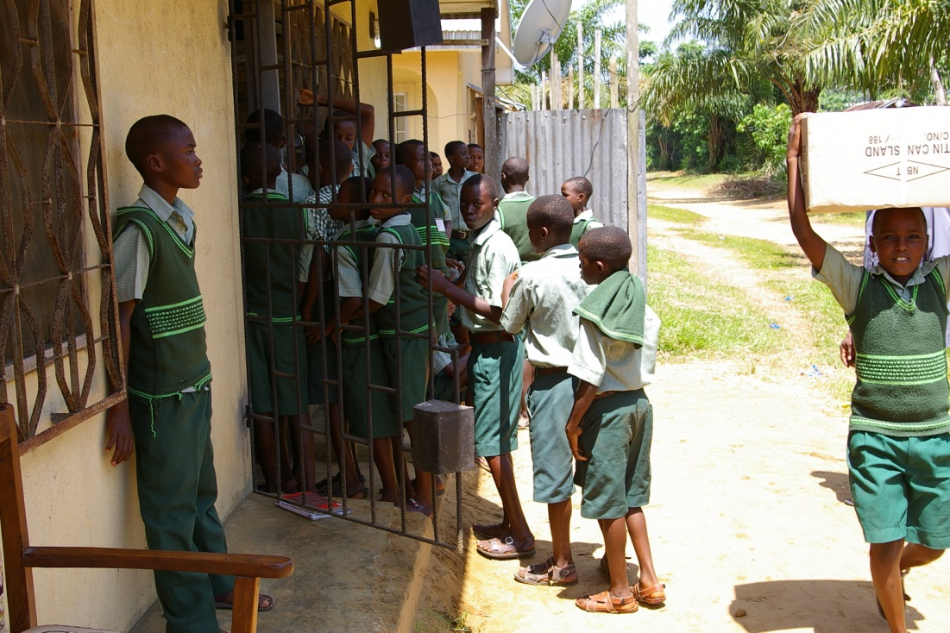
… school children helped to transfer them..

Slide 17
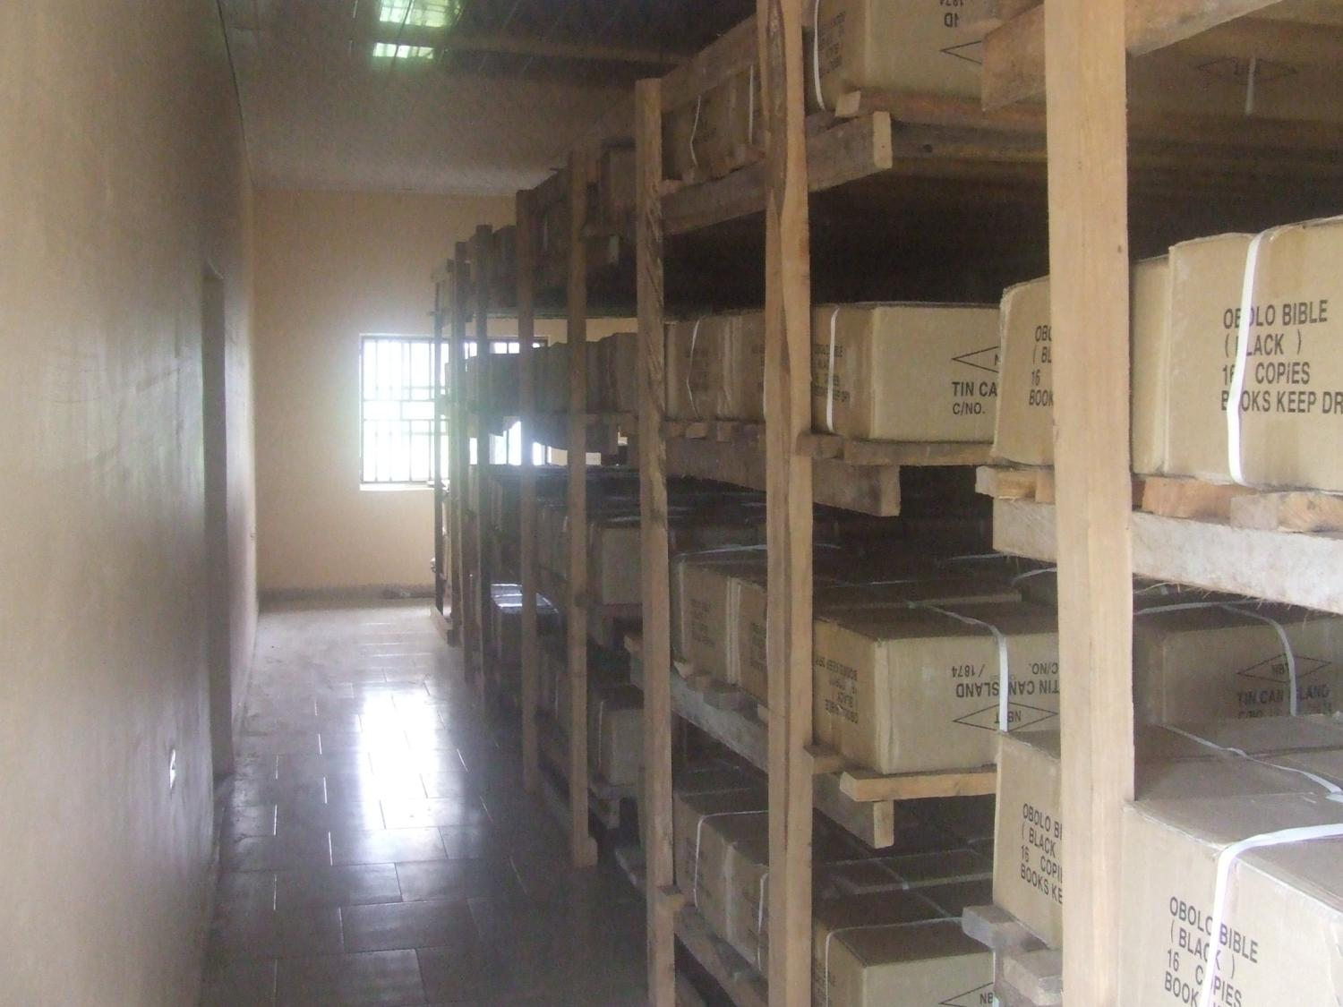
…finally onto the shelves …

Slide 18
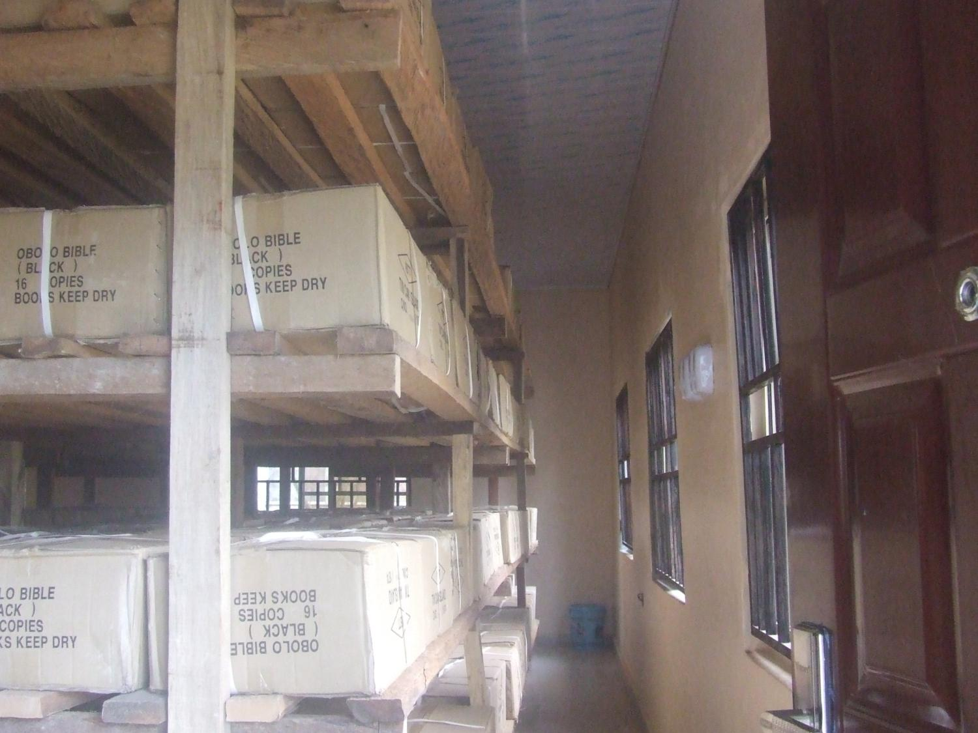
… in the Bible Store in the Warehouse

Slide 19
PRESENTATION OF THE OBOLO BIBLE TO THE OBOLO PROJECT COMMITTEE
FIRST EVER SIGHTING OF THE OBOLO BIBLE!
A MOMENT OF GREAT JOY!!!

Slide 20
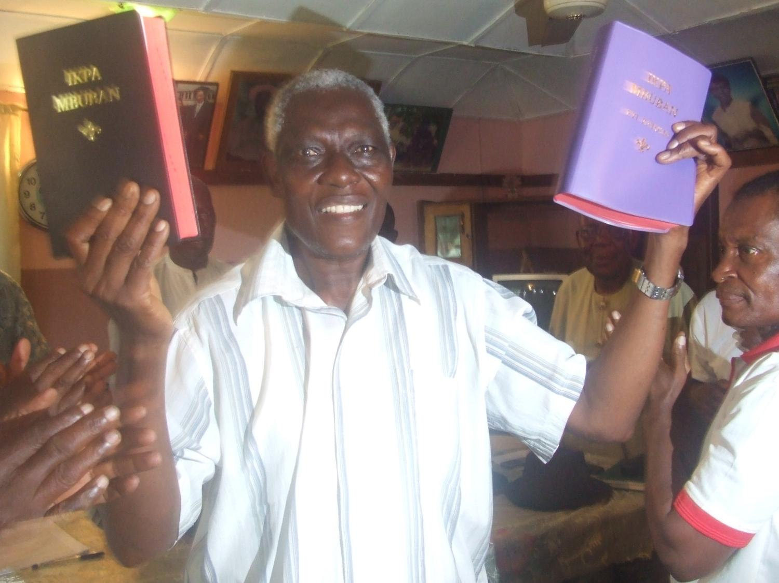
OBOLO BIBLE:
1st in Akwa Ibom State
2nd in Rivers State
23rd in Nigeria
164th in Africa
515th in the whole world

Slide 21
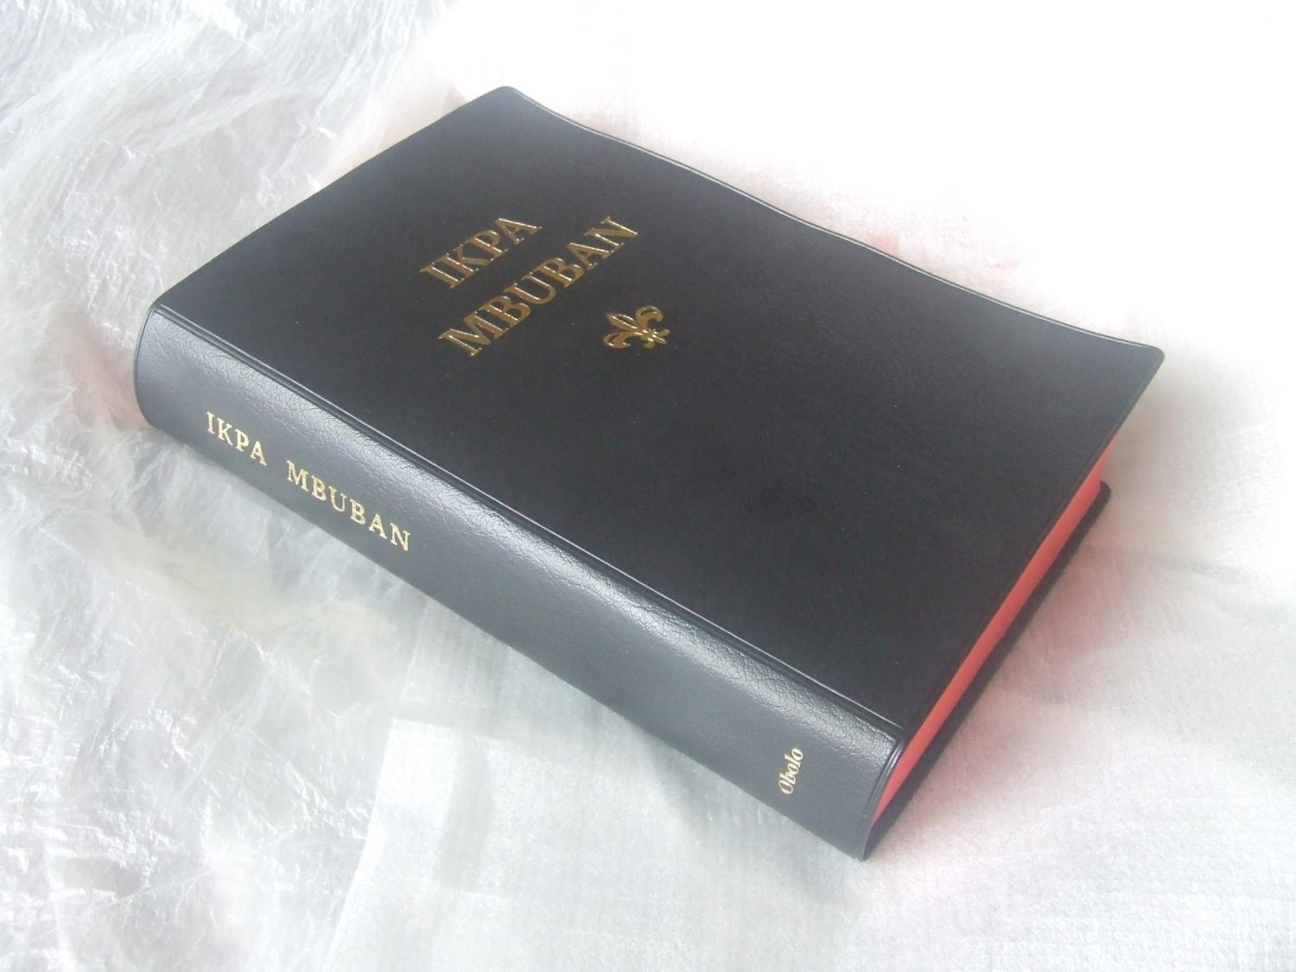
… Protestant …

Slide 22
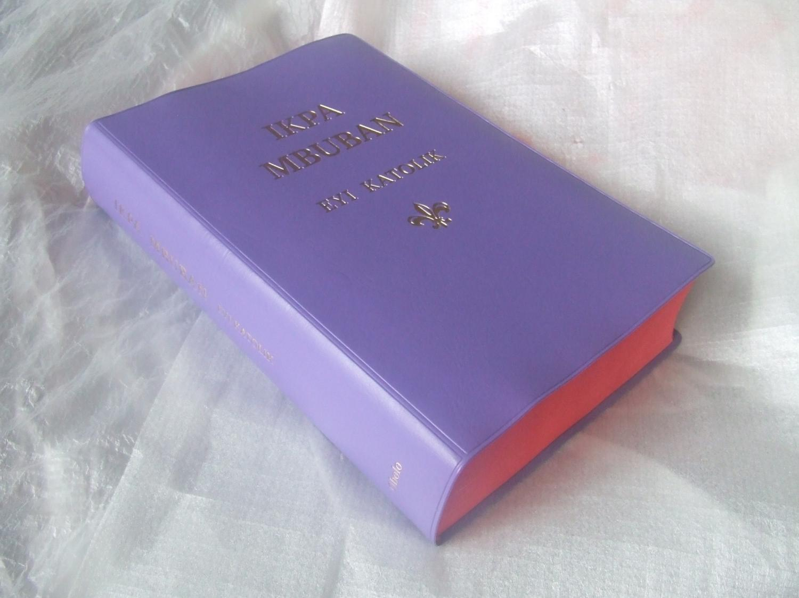
… Catholic

Slide 23
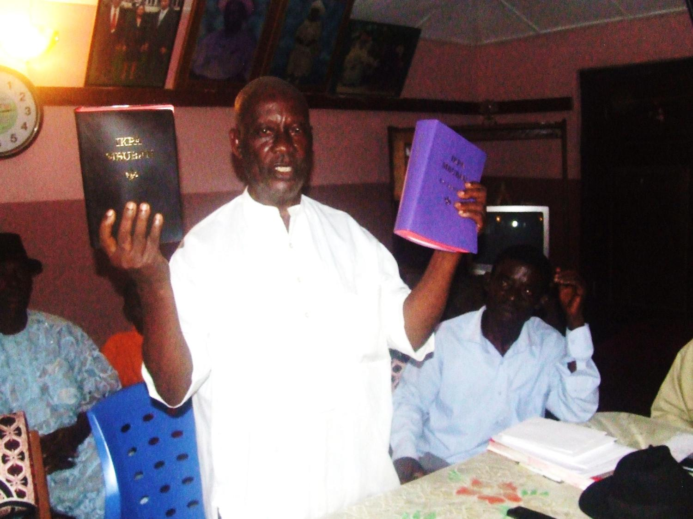
Project Coordinator
with the Bibles

Slide 24
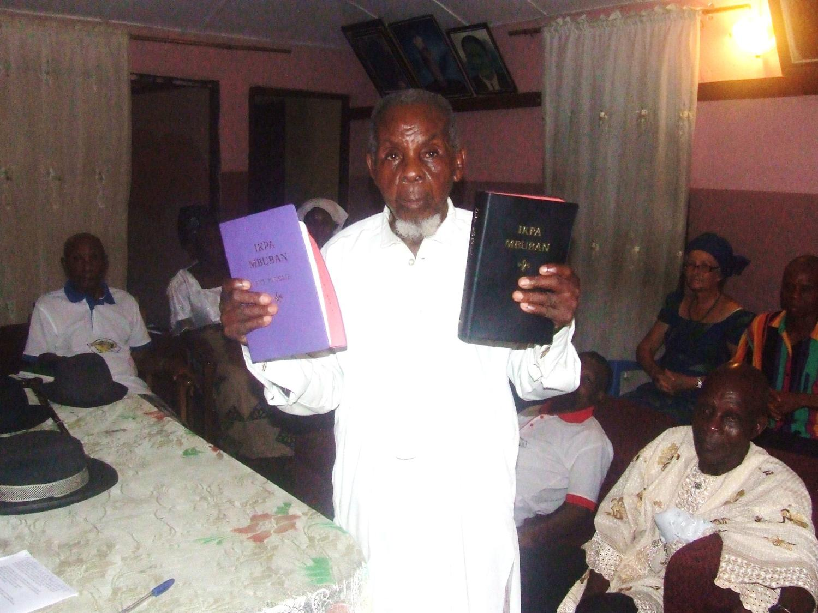
The oldest Committee member with the Bibles

Slide 25
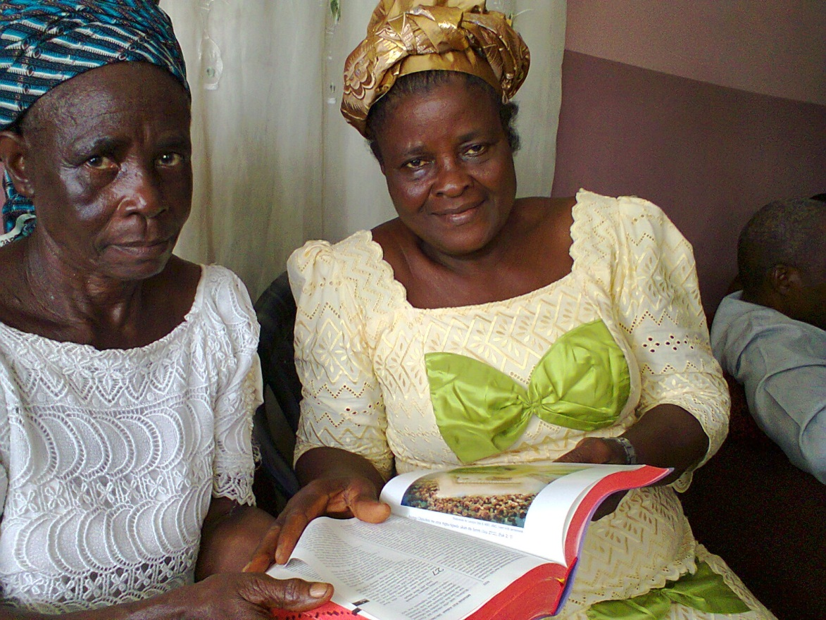
Opening the Bible?
IRRESISTIBLE

Slide 26
DEDICATION OF THE OBOLO BIBLE AT AGWUT OBOLO ON SATURDAY MAY 24, 2014

Slide 27
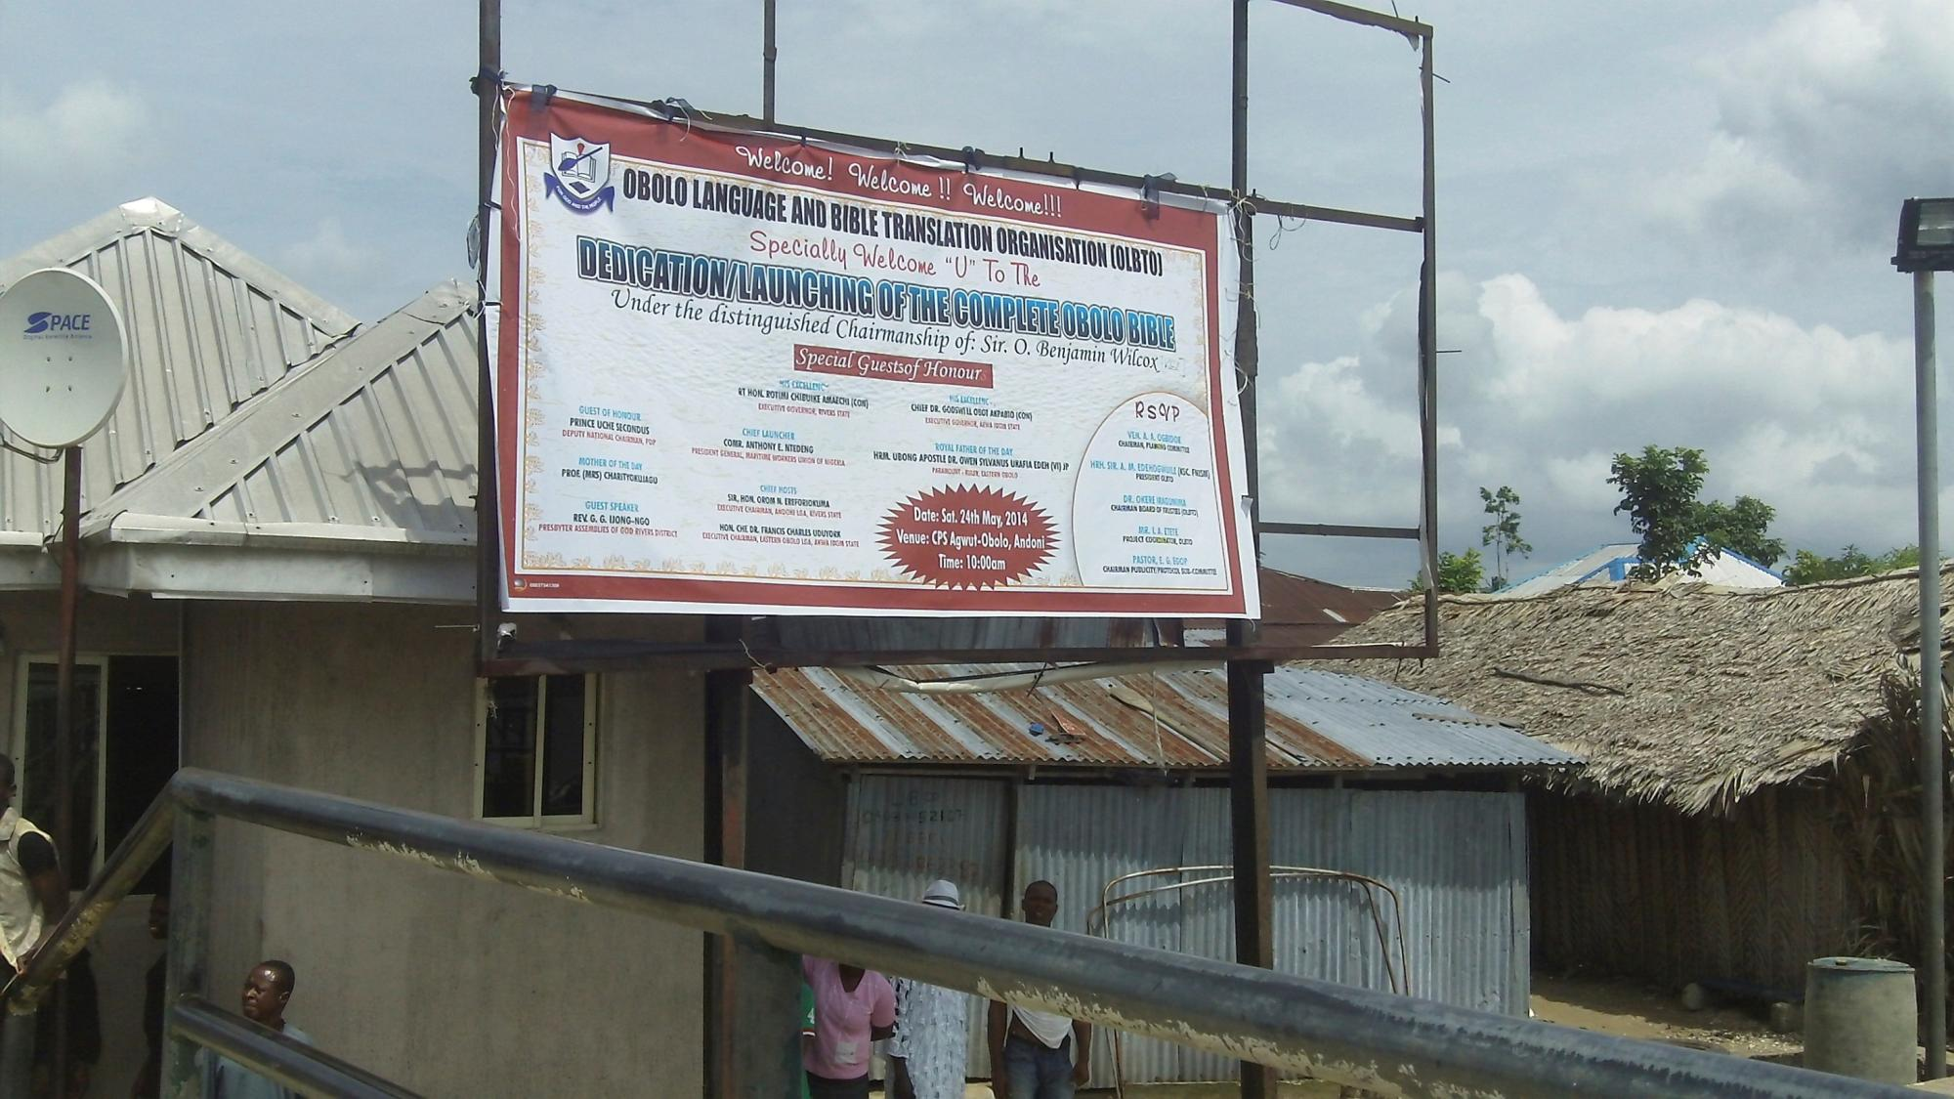

Slide 28
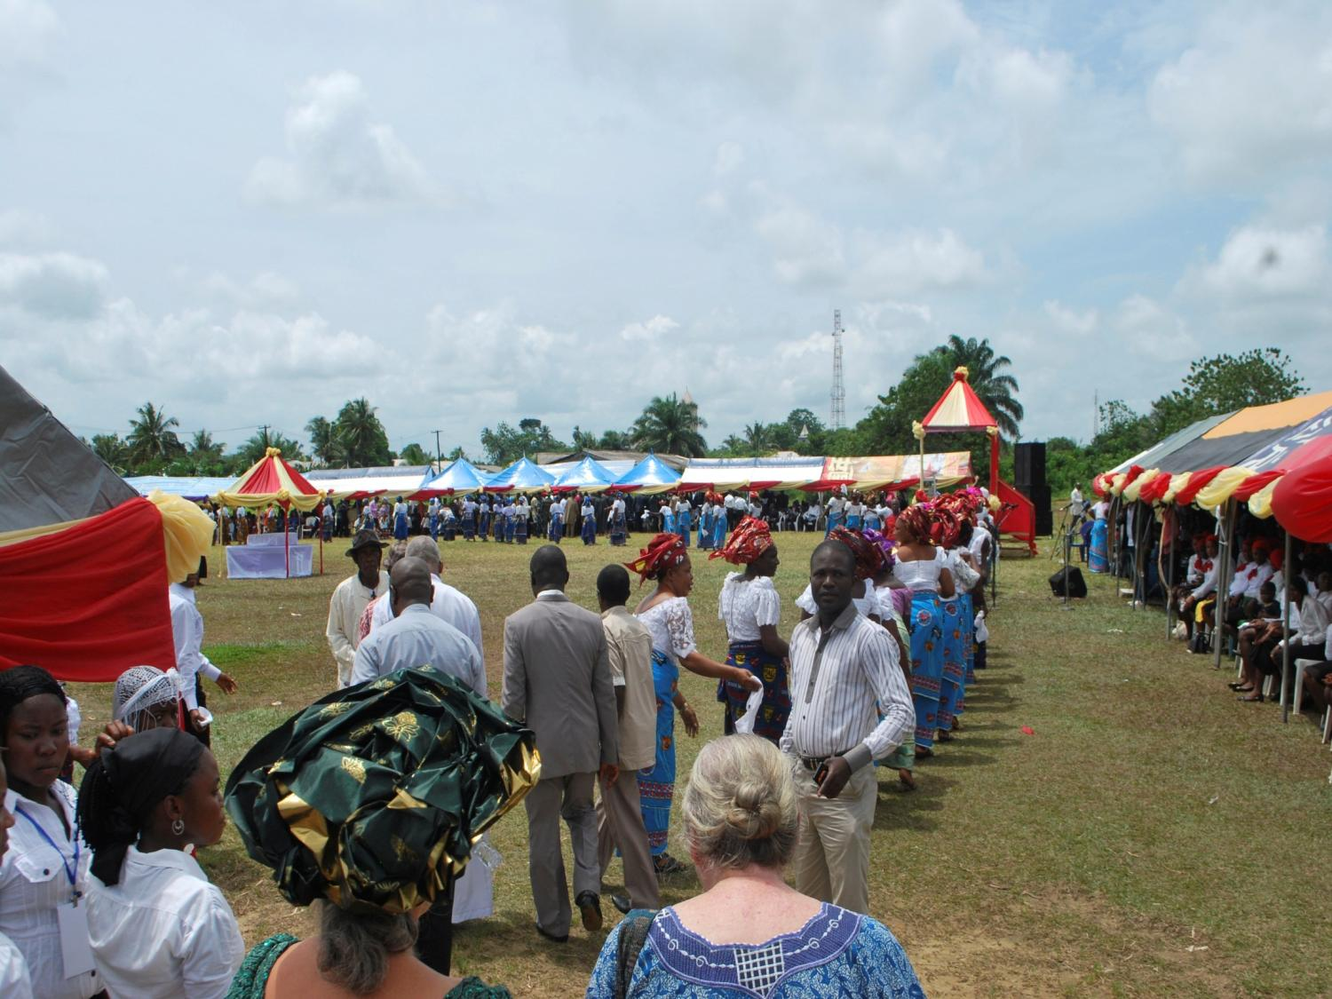
Dedication arena

Slide 29
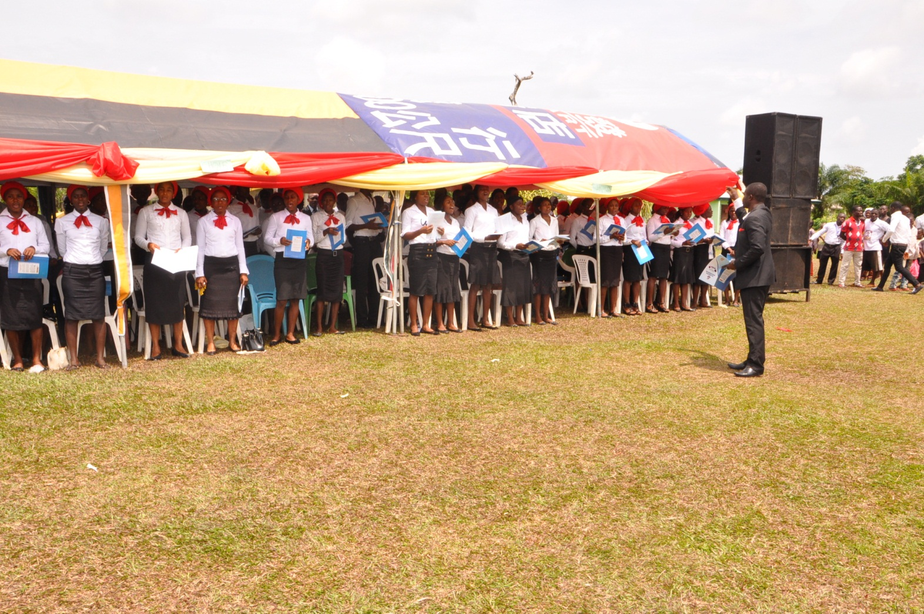
Choir presentation

Slide 30
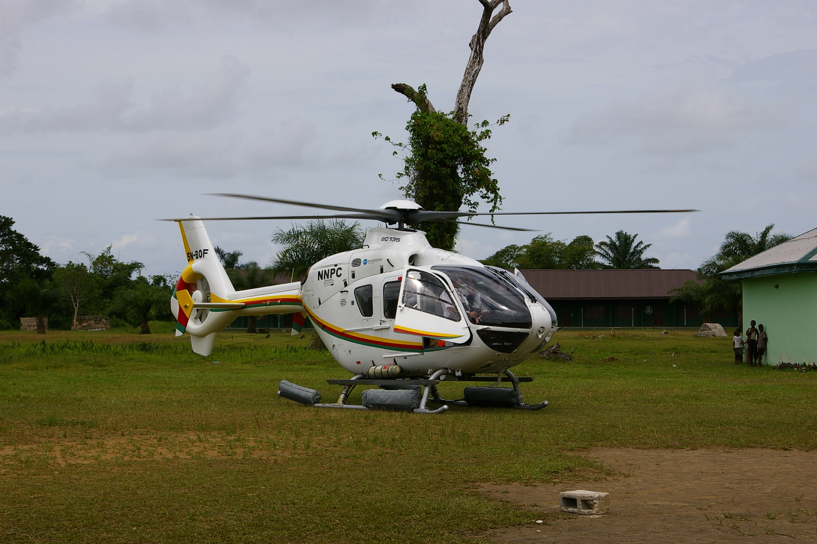
Top dignitaries arrive

Slide 31
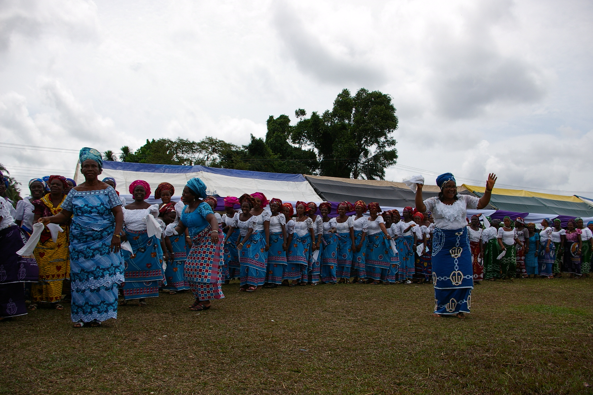
Women dancing

Slide 32
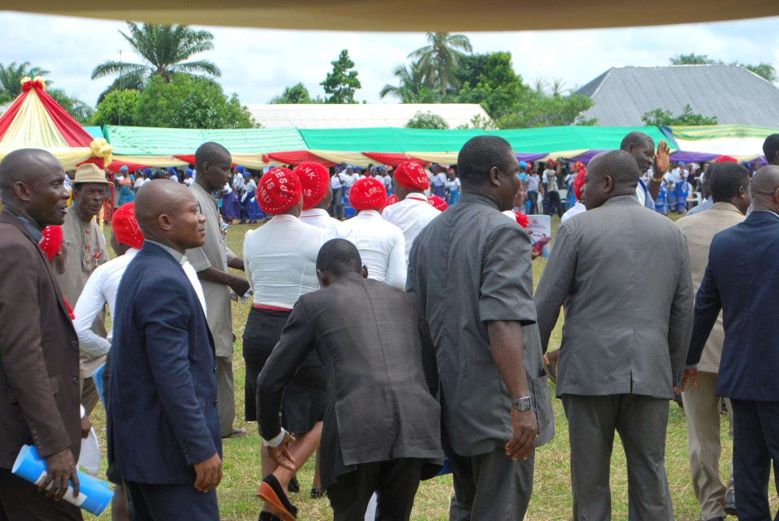

Slide 33
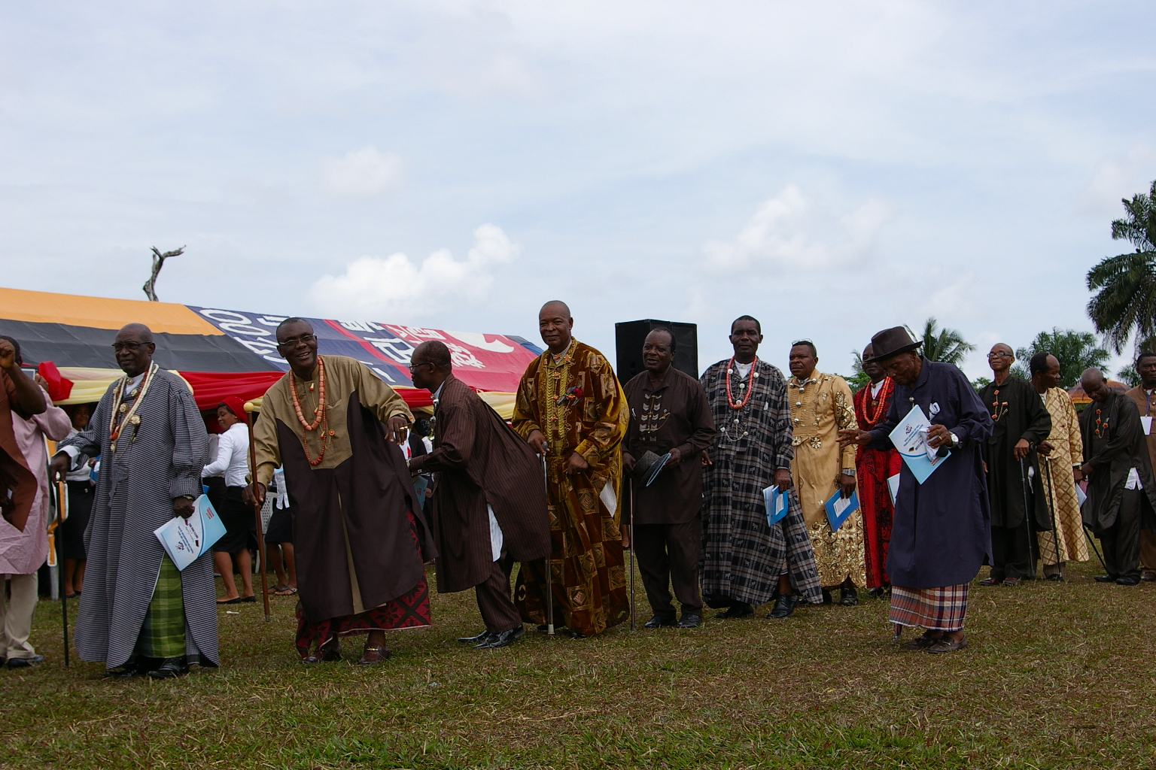
The chiefs could not remain seated

Slide 34
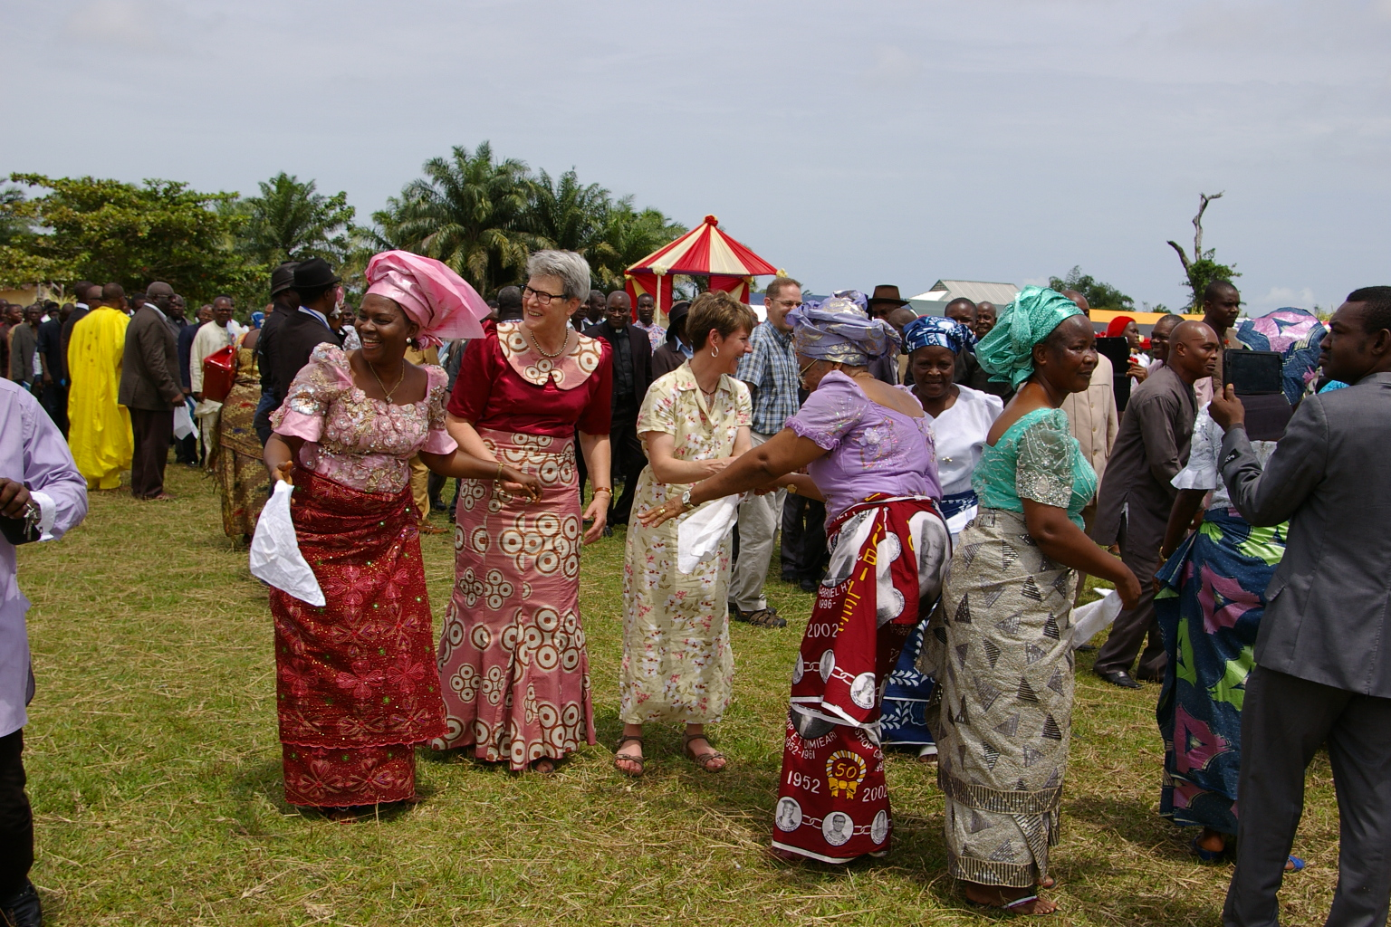
Even foreign guests could not resist the pull

Slide 35
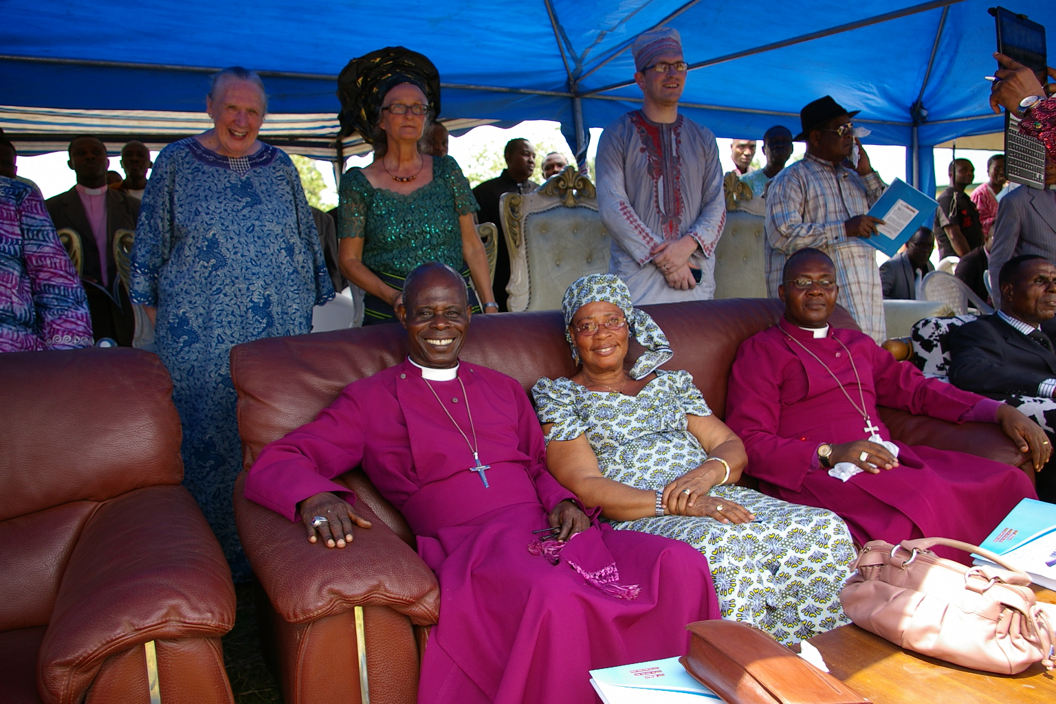
The VIPs

Slide 36
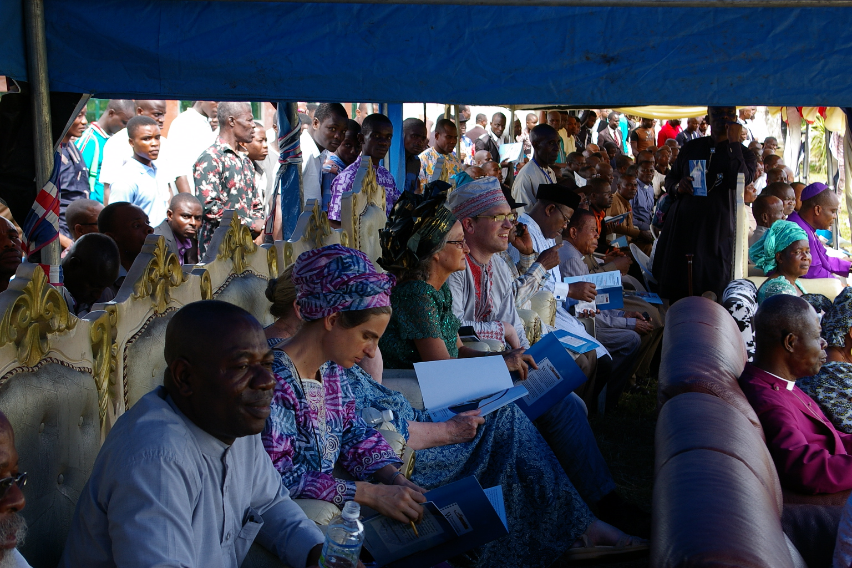

Slide 37
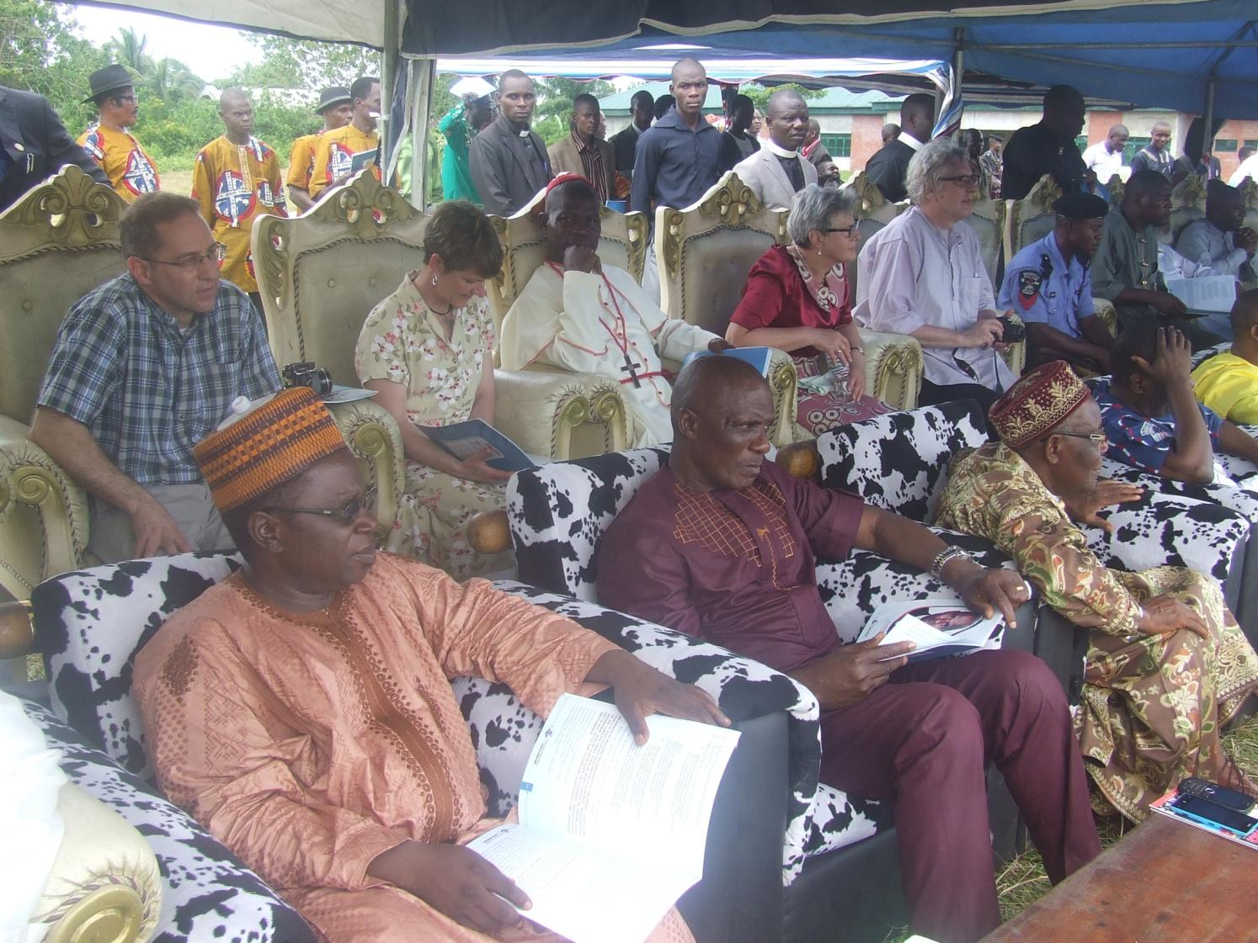

Slide 38
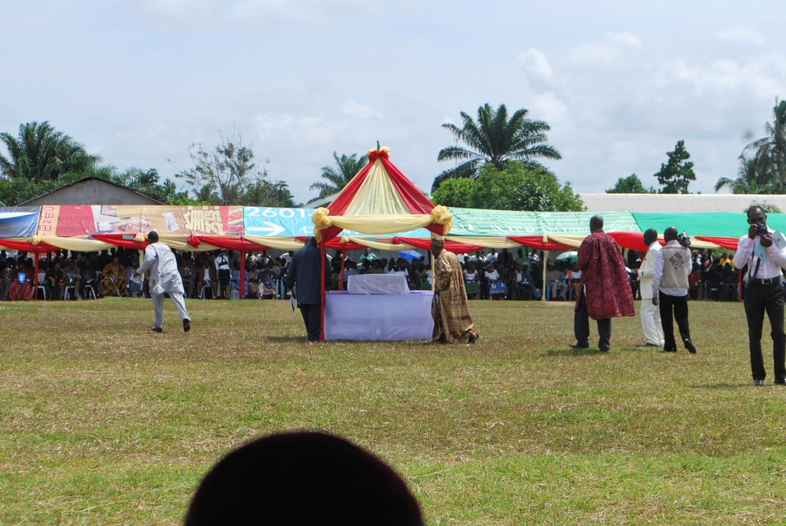
People start to stream to the “Shrine of the Book”

Slide 39
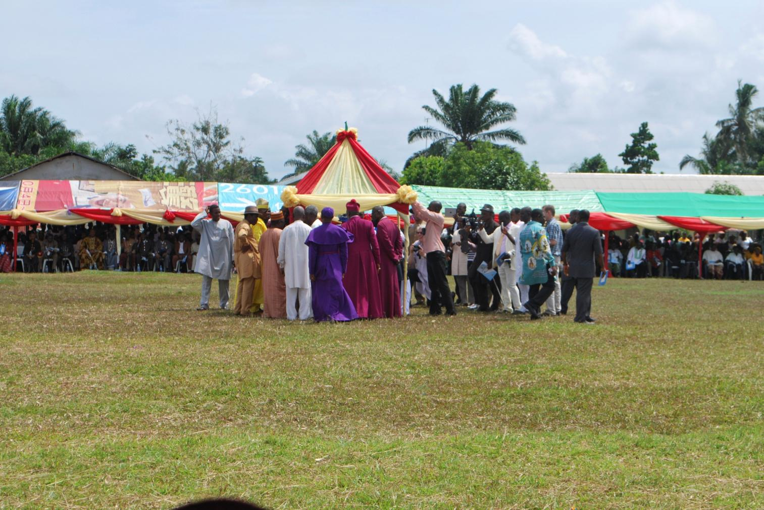

Slide 40
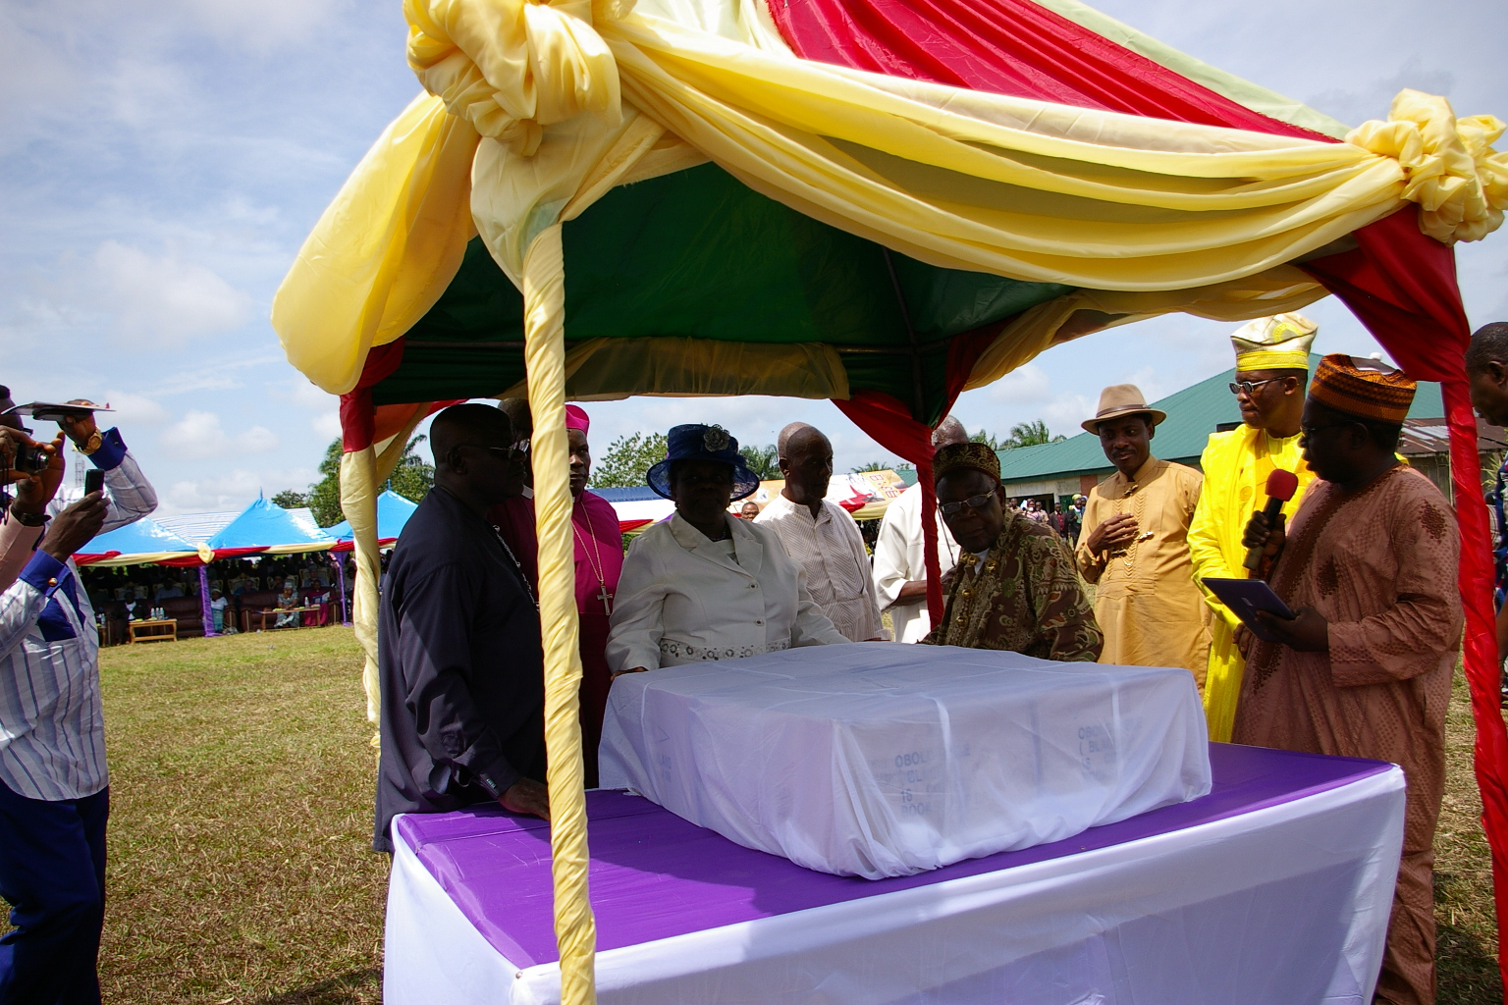
Nigeria Bible Translation Trust (NBTT) Executive Director
gives a speech

Slide 41
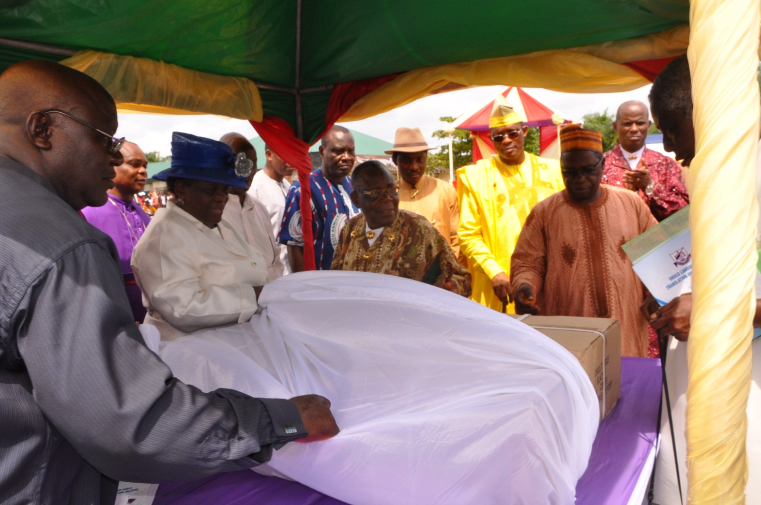
The cartons are unveiled …

Slide 42
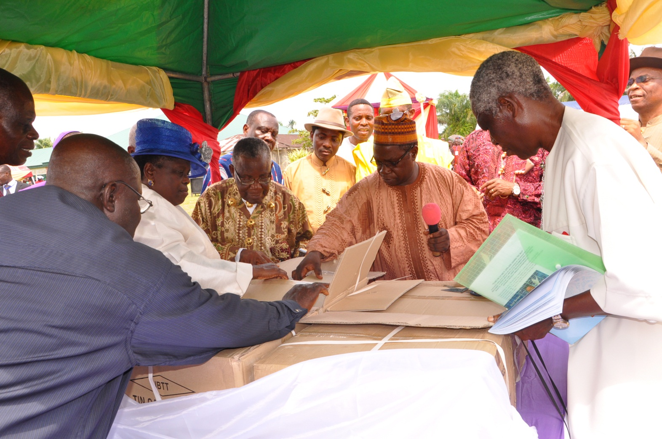
… opened …

Slide 43
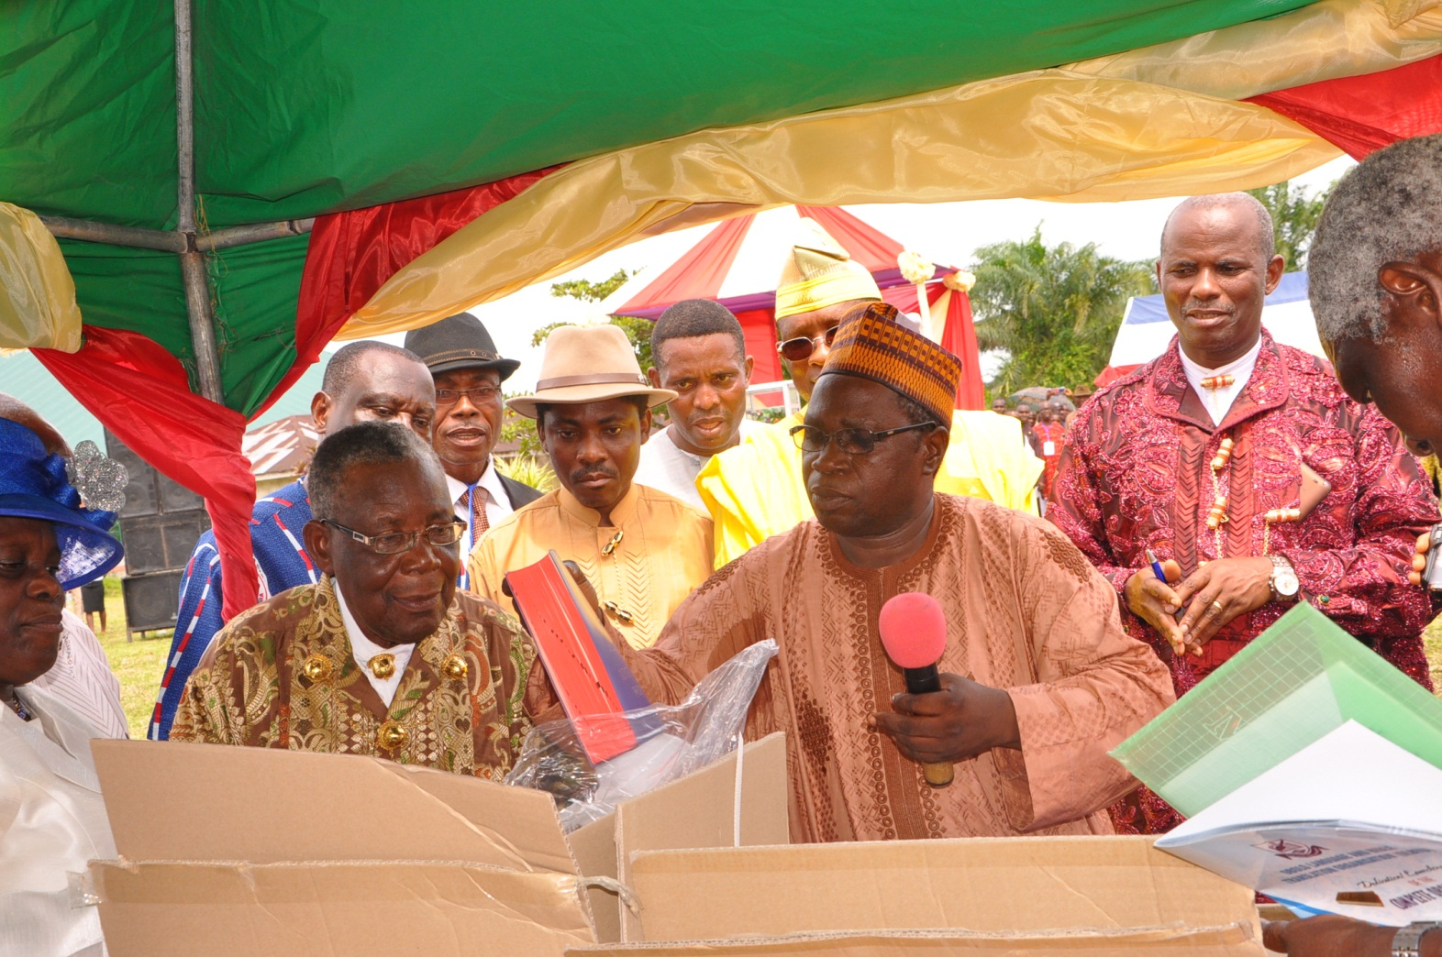
… NBTT Executive Director brings out the Bibles …

Slide 44
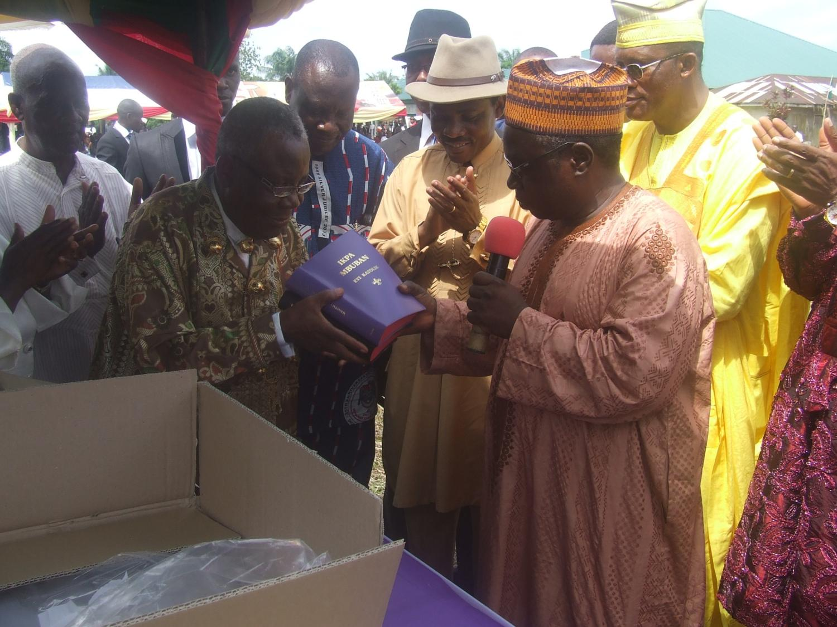
… and presents them to Obolo Language & Bible Translation Organization (OLBTO) President…

Slide 45
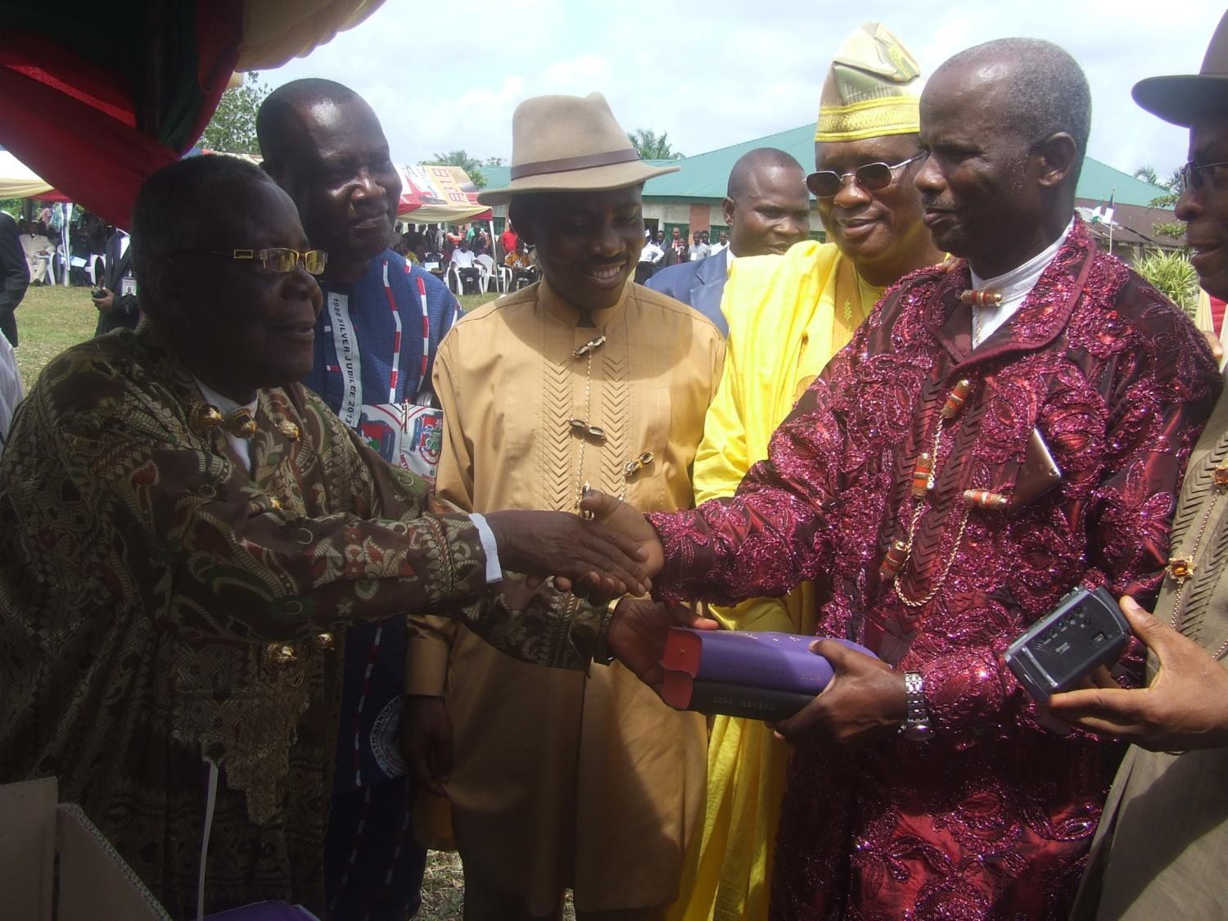
OLBTO President hands them over to Board Of Trustees (BOT) Chairman … and…

Slide 46
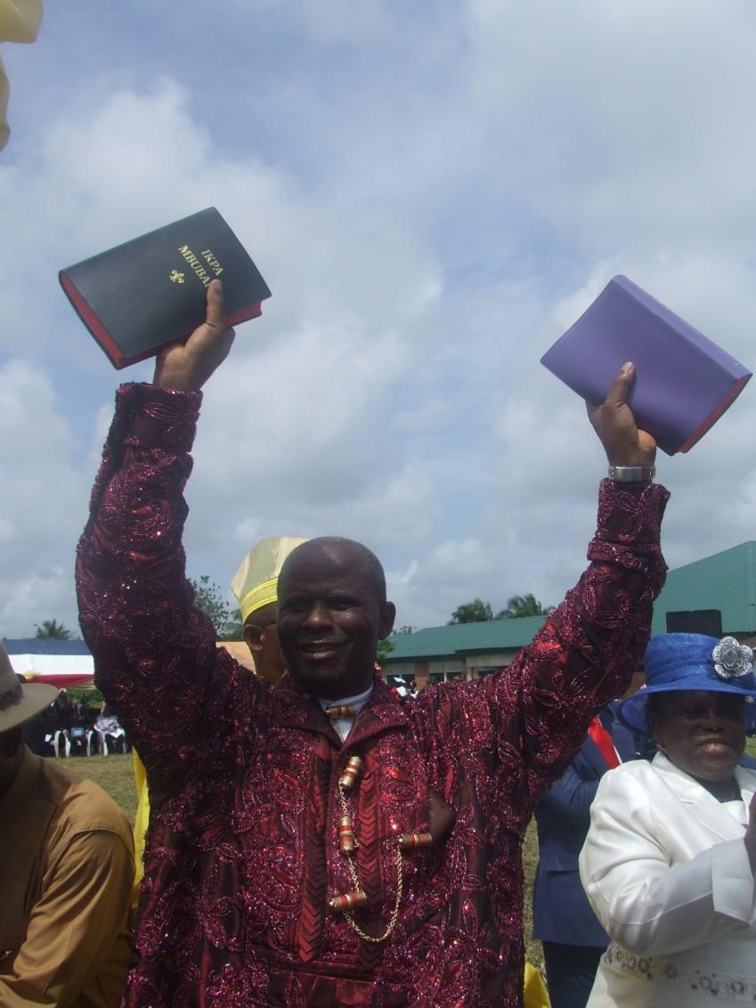
… the crowd explodes!
HALLELUYAH!!!

Slide 47
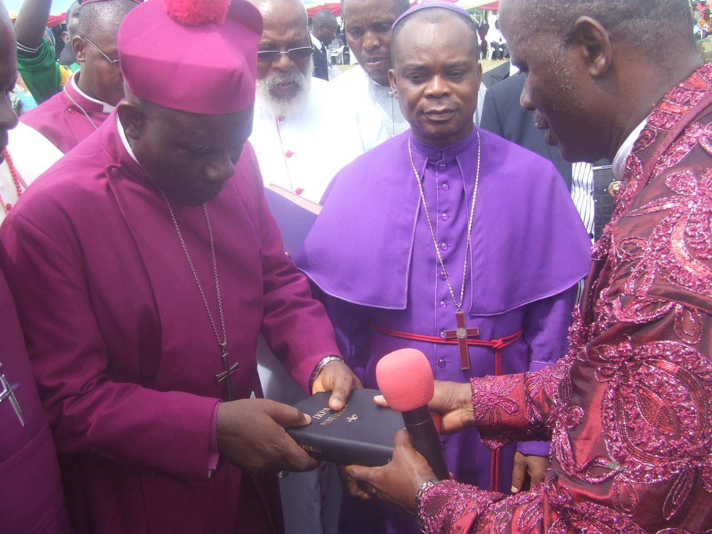
BOT Chairman hands them over to the clergy …

Slide 48
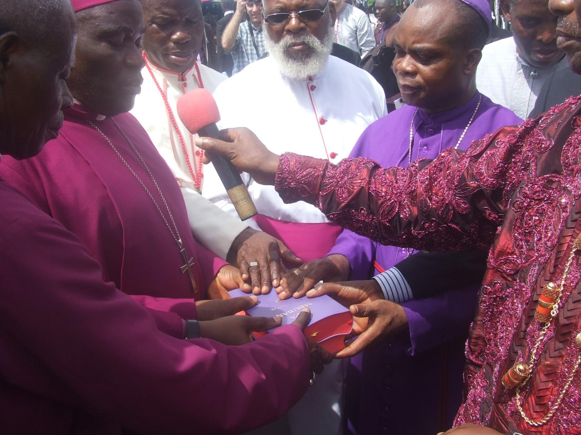
… and the clergy say the Dedicatory Prayer

Slide 49
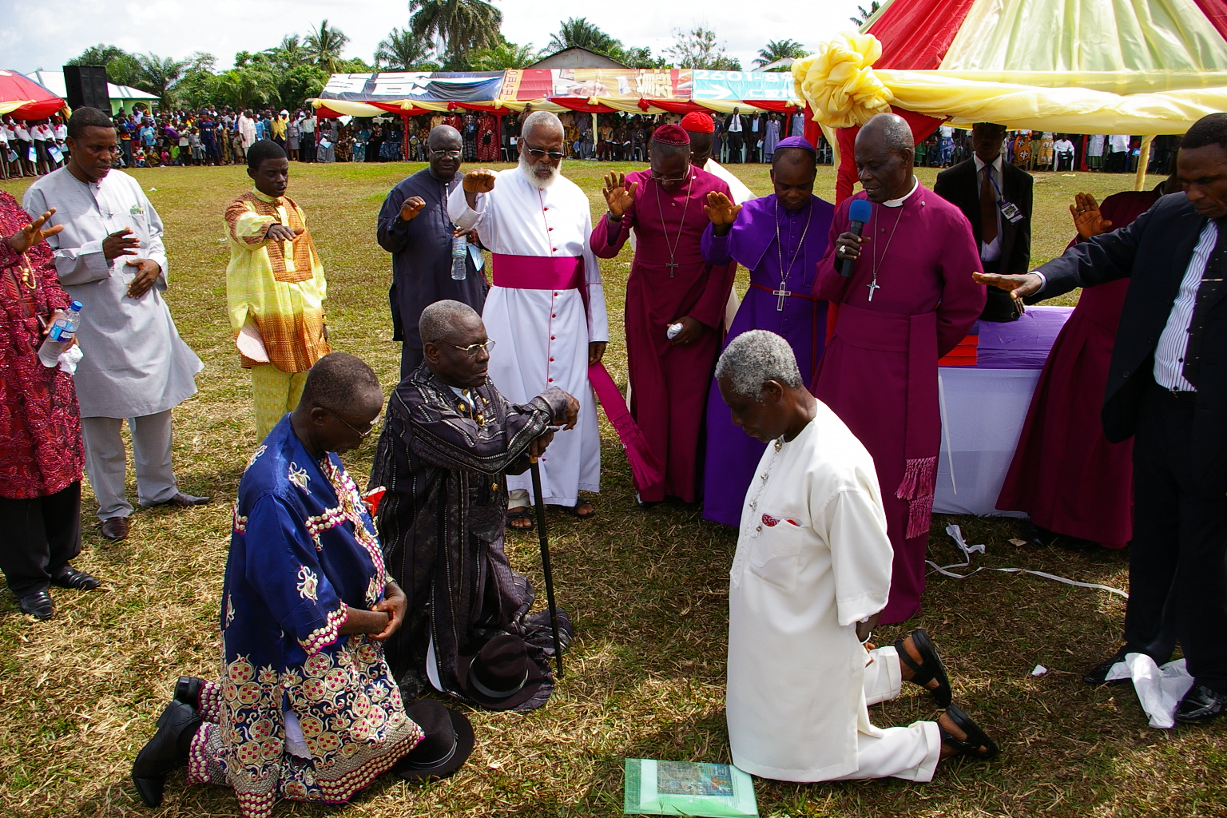
Prayer for Translators & Consultant

Slide 50
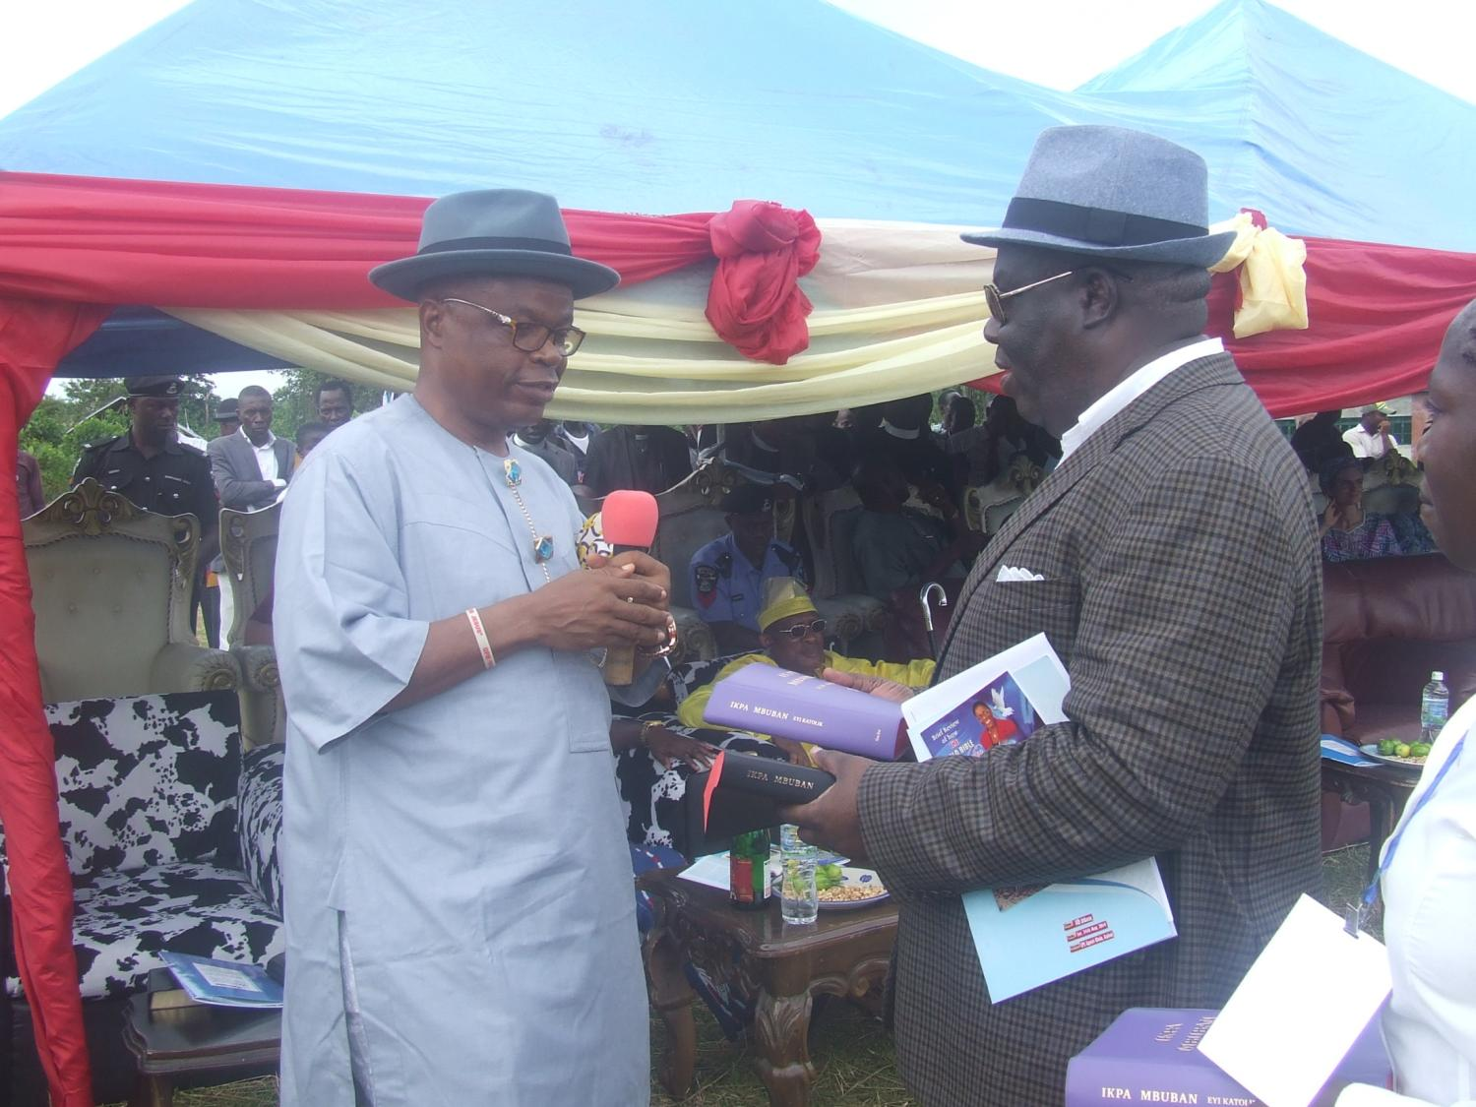
Chairman of the occasion
Rivers State Governor’s Representative

Slide 51
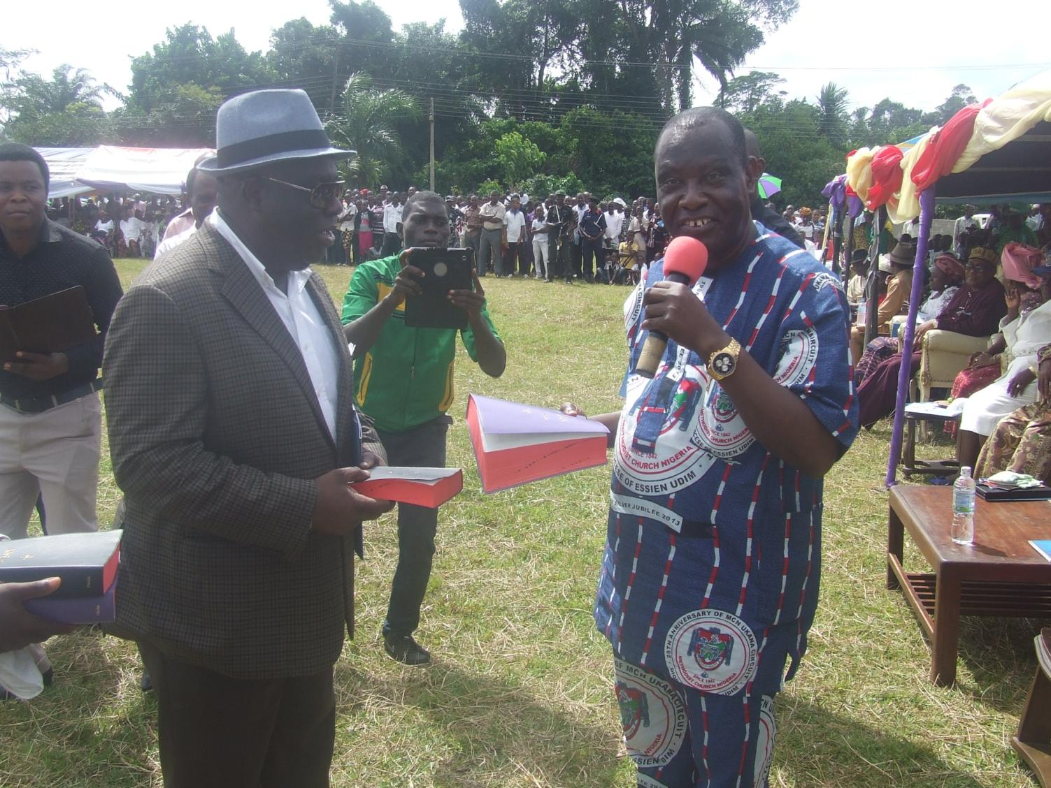
Akwa Ibom State Governor’s Representative
& OLBTO BOT member

Slide 52
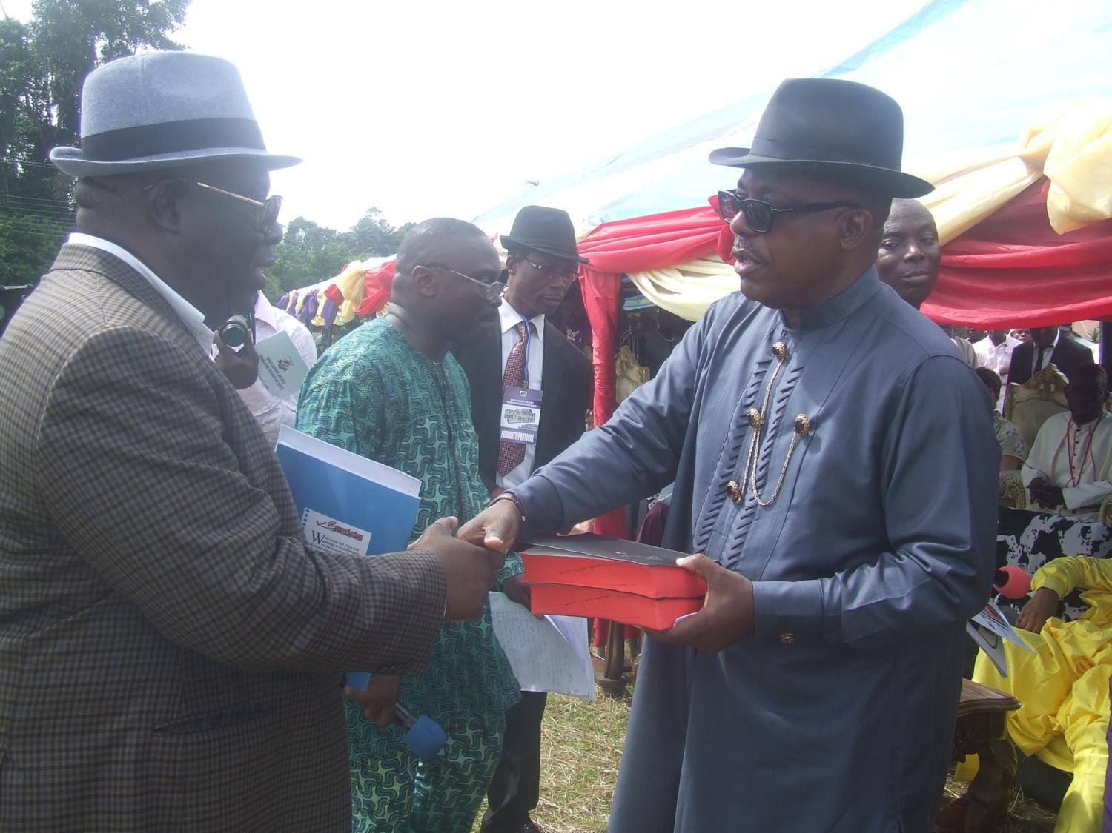
Representative of the President of Nigeria

Slide 53
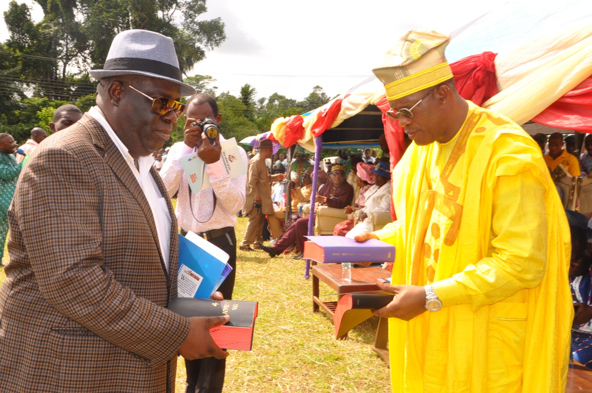
Commissioner in Niger Delta Development Commission & OLBTO BOT member

Slide 54
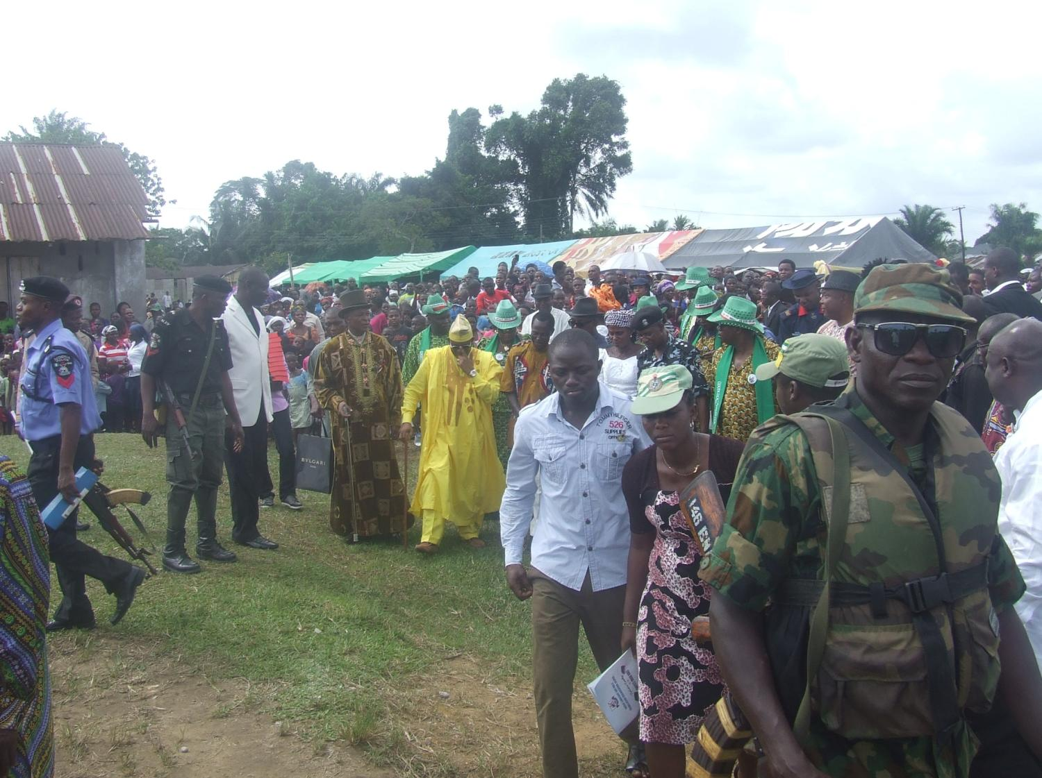
Top dignitaries depart

Slide 55


Slide 56

Chiefs promise to rule by the Bible

Slide 57

Rush for the Bible

Slide 58

Bible rush intensifies

Slide 59


Slide 60

This is it!

Slide 61

Goodbyes

Slide 62

Dinner for special guests at the Local Government Council lodge

Slide 63

Foreign guests

Slide 64

Local Government Chairman & his family
(in the middle) & staff mixed freely with the guests

Slide 65

As visitors returned across the river that same day…

Slide 66

… they found people already reading the Bible!!

Slide 67

First use of Obolo complete Bible
in an Obolo church, May 25, 2014

Slide 68


Slide 69

OBOLO BIBLE THANKSGIVING CEREMONY AT OKOROETE, EASTERN OBOLO, SATURDAY,
JULY 5, 2014

Slide 70

Opening Prayer by Chairman of Dedication Committee

Slide 71

Opening Hymn

Slide 72

Dancing …

Slide 73

… dancing …

Slide 74

… and dancing

Slide 75

OLBTO President hands over the Bibles to BOT members

Slide 76

BOT members hand over the Bibles to Eastern Obolo clergy

Slide 77
OBOLO BIBLE PRESENTATION
OUTSIDE OBOLO LAND

Slide 78

ECWA PLATEAU CHURCH, JOS
NIGERIA

Slide 79



Slide 80

Presentation To Bernie May and family in
UNITED STATES OF AMERICA

Slide 81

Highland Park Baptist Church UNITED STATES OF AMERICA

Slide 82

To Highland Park Baptist Church
Bernie May
Pastor

Slide 83


Slide 84


Slide 85

To our family and Church in
THE NETHERLANDS

Slide 86

FREE EVANGELICAL CHURCH, RIJNSBURG
THE NETHERLANDS

Slide 87


Slide 88


Slide 89
AFTER THE OBOLO BIBLE
WHAT NEXT?
OBOLO BILingual
institution
Primary school
SECONDARY SCHOOL
polytechnic

Slide 90

Primary One started already in October 2014…
… in the Bible Ware House

Slide 91

Teacher and the pupils

Slide 92


Slide 93

Headmaster in his office

